Slide 1
assessing the impact of gambling
CONCEPTS, CONTROVERSIES AND
Next steps
Presented by Dr Matthew Browne
WHO Istanbul December 2019

Slide 2
outline
THEORETICAL AND CONCEPTUAL FRAMEWORK
BRIEF SUMMARY OF THE ‘BURDEN OF HARM’ PROJECTS IN AUSTRALIA AND NEW ZEALAND
LIMITATIONS, IMPLICATIONS, ‘CONTROVERSIES’
CURRENT WORK AND CONCLUSIONS

Slide 3
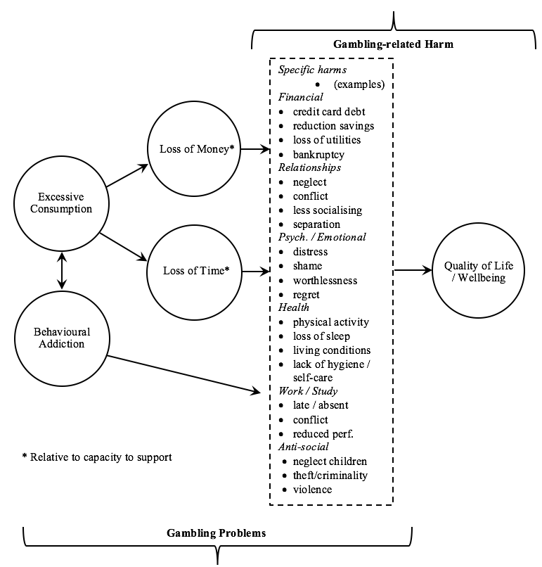
A Basic THEORETICAL MODEL of harm(S)
adverse consequence due to an engagement with gambling that leads to a decrement to health or wellbeing
Notes:
Excessive consumption and behavioral addiction tend to

Slide 4
A Basic THEORETICAL MODEL of harm(S)
CAUSAL MECHANISM
OUTCOME
RISK FACTOR
SYMPTOMATOLOGY
Notes:
Excessive consumption and behavioral addiction tend to

Slide 5
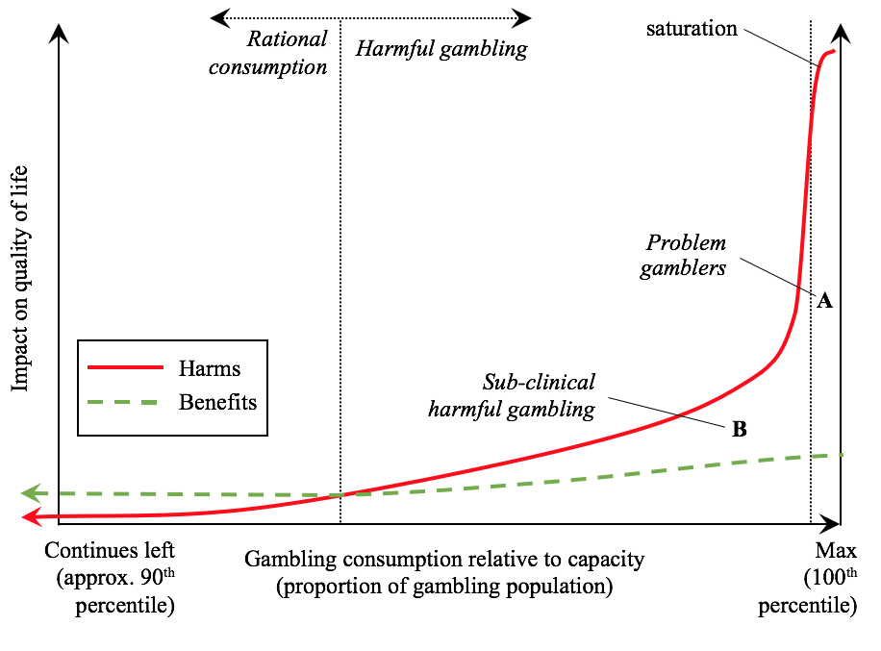
distribution of harm in the POPULATION
Notes:
The prevention paradox - is the area denoted by ‘B’ bigger than the area denoted by ’A’
Is the distinction between rational (beneficial) vs non-rational (non-beneficial) consumption just as important as the PG threshold?

Slide 6
distribution of harm in the POPULATION
CONTINUOUS
CONTINUOUS
Notes:
The prevention paradox - is the area denoted by ‘B’ bigger than the area denoted by ’A’
Is the distinction between rational (beneficial) vs non-rational (non-beneficial) consumption just as important as the PG threshold?

Slide 7
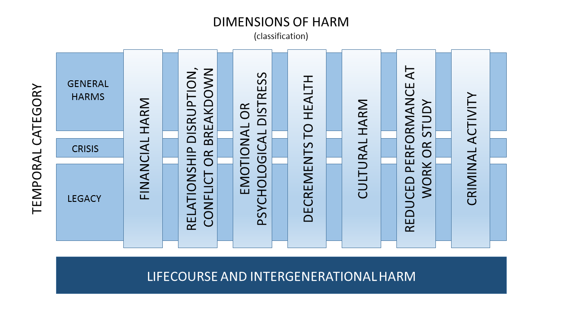
A taxonomy of impact
Notes:
This is a taxonomy of the specific negative consequences that can arise due to gambling
Every gambler will experience a different profile of consequences
Both the gambler and the CSO can experience harms in each of these domains

Slide 8
Challenges & objectives
Treating impact as a ‘liquid’ quantity (health utility), rather than classifying qualitative differences (e.g. PG prevalence)
Assessing impact on the continuum of gambling problems
Not just for pathological gamblers
Full epi. model of incidence, recovery, relapse, not available
Dedicated measures of gambling harm
Health state utilities
Attributing causation

Slide 9
A simple approach to take into account severity and prevalence
Population
Prevalence Gambling State (%)
Disability Weight of Health State
YLD1 =
Direct elicitation
PGSI

Slide 10
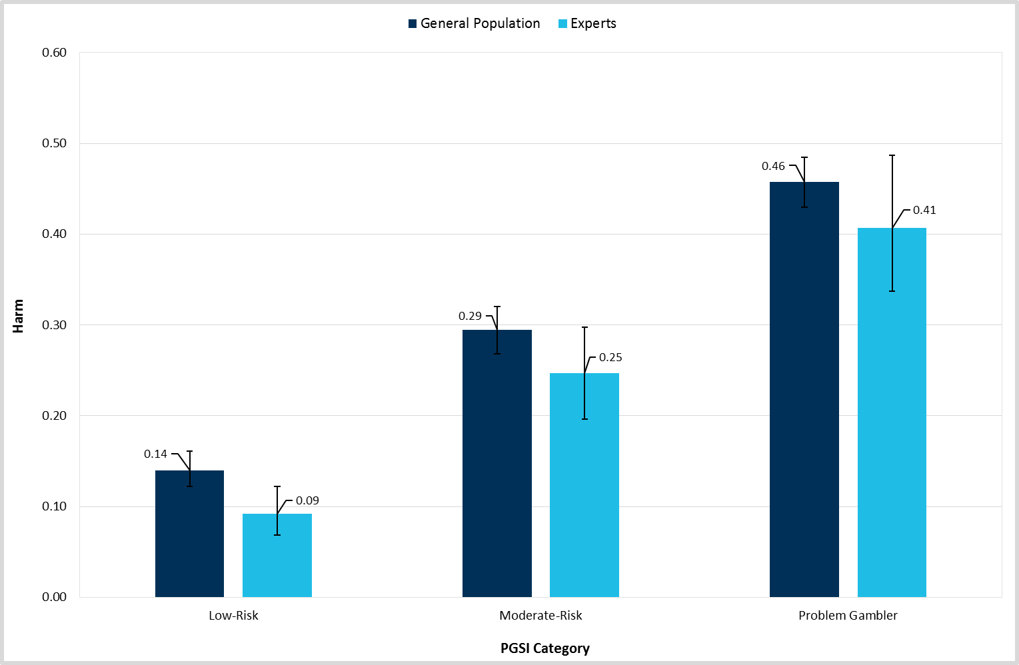
Direct elicitation of impact to Qol
Survey harms associated with each degree of condition severity
Present experts and community members with vignettes describing those harms
Elicit DW via TTO and other methods
Average with respect to PGSI
(Victoria, Australia)
Harm by sample type and PGSI category

Slide 11
Results: a measure of the severity of the condition
New Zealand
Harm utilities for gambling harm compared to other health states

Slide 12
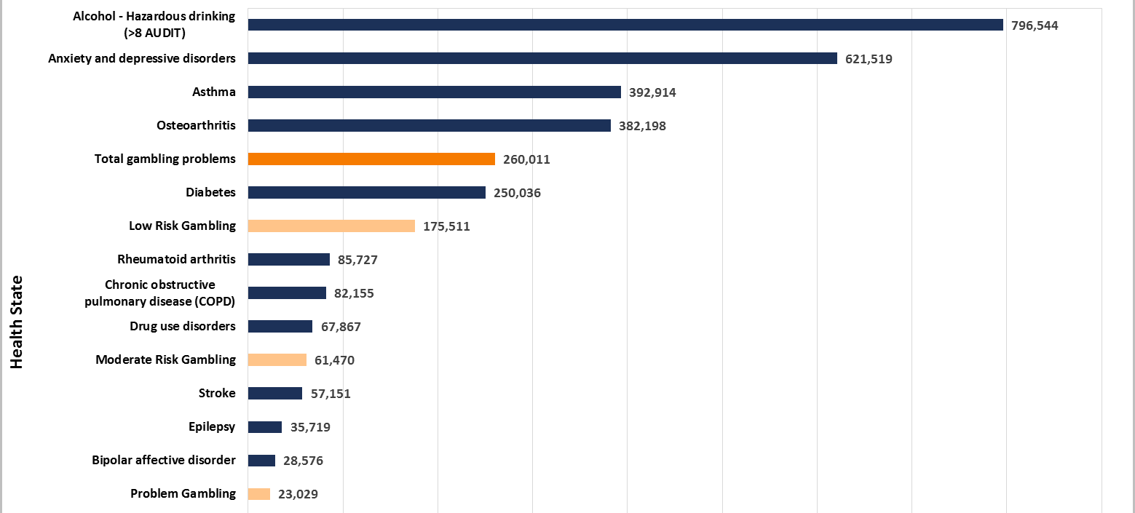
Results: a measure of aggregate population impact
New Zealand
Annual prevalence of gambling problems (by PGSI category) and other health states in the New Zealand

Slide 13
Limitations
Though strongly data-driven, these methods rely on:
Respondents to correctly attribute the nominated harms to gambling (causality)
Experts and community to correctly assess the impact on QoL
A health utility framework for elicitation and aggregation of utility

Slide 14
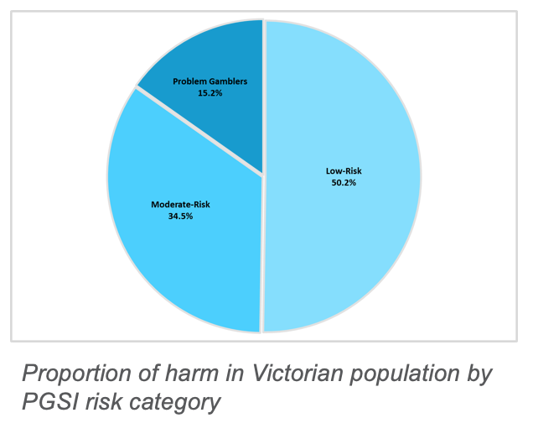
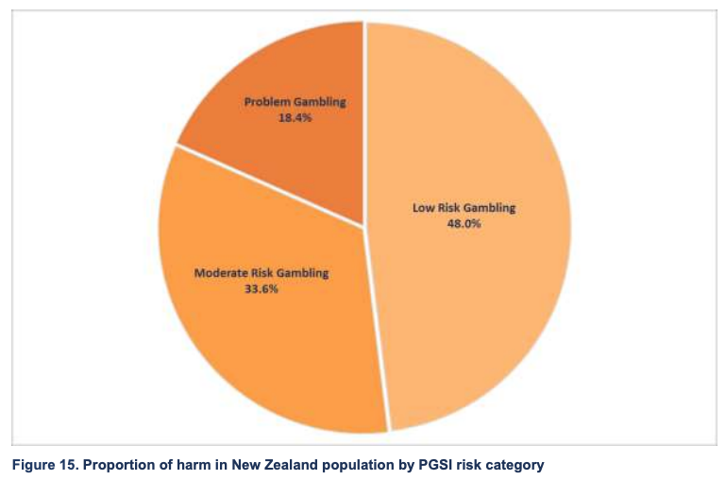
The most ‘controversial’ implication
That health and wellbeing impact extends beyond pathological gamblers
Victoria, Australia
New Zealand

Slide 15
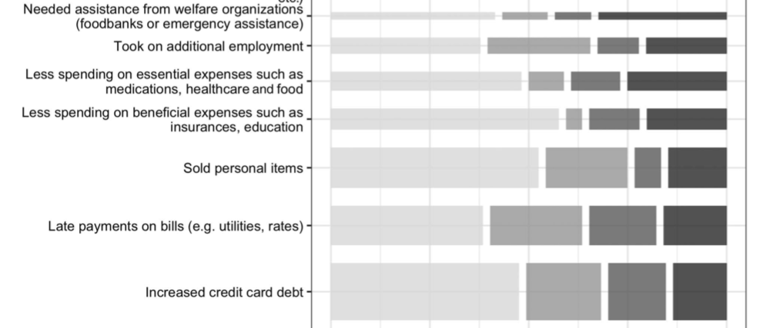
Triangulation (1)
Population Prevalence of symptomatology (no utility elicitation)

Slide 16
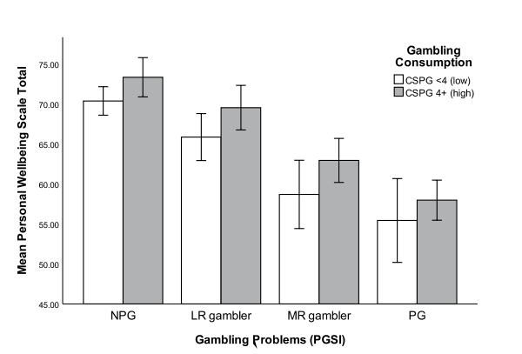
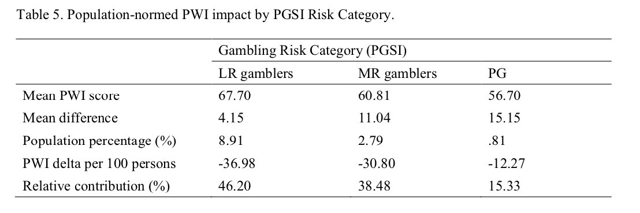
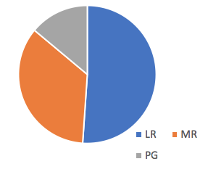
Triangulation (2)
Decrements to self-reported wellbeing, controlling for covariates

Slide 17
Research in progress
Strong industry-sponsored pushback against quantifying impact
Australian project for indirect elicitation of HUW via the SF-6D
No assumption of correct attribution by participants
Case-control matching, weighting and statistical control for all relevant covariates (age, SES, etc)
’water-tight’ evidence for the counterfactual and causality
Exciting potential for analysis of bank transaction (big) data
More triangulation
The ‘opportunity costs’ of excessive gambling spending
Health, financial insecurity, etc

Slide 18
conclusions
How we measure gambling impact influences both theory and policy
The status-quo
Conflation of clinical criteria for pathology, with impact of financial losses
Implicit assumption of harm only to those with mental disorder (‘at risk’)
Downplays the intrinsic risk associated with products
Qualitative, categorical thinking
Where we need to be
Robust quantification of the impact accruing to different segments of society
Counting the cost of gambling, and rational weighting against public revenue
Precise and unambiguous measurement of the contribution of different products
Adopting a clear-eyed view of the mechanism – unsustainable financial losses

