Slide 1

Participation to the UNODC Youth Forum
Merve Yetiştirici ve Erkin Özgür

Slide 2
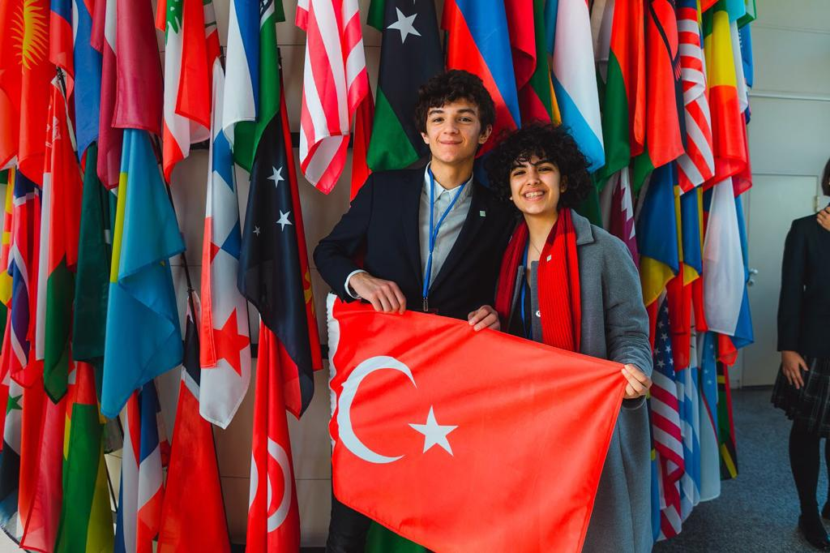
Who We Are ?
MERVE
ERKİN

Slide 3
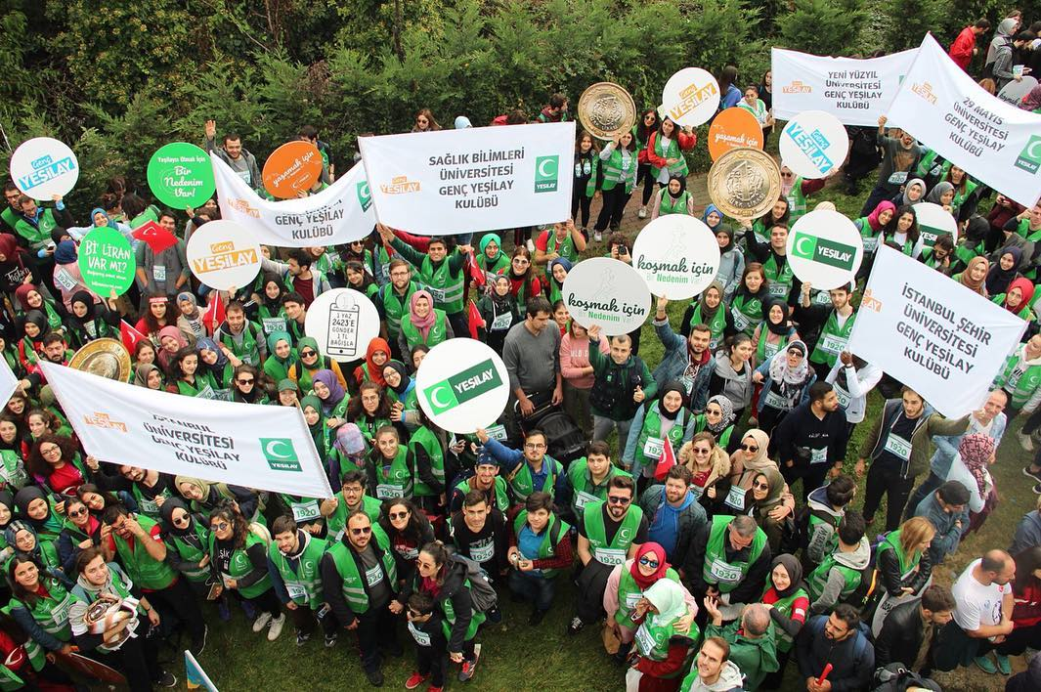
Volunteers of Green Crescent
Hundreds of thousand Green Crescent Volunteers are a role model to the society and working for a life free from addictions.

Slide 4
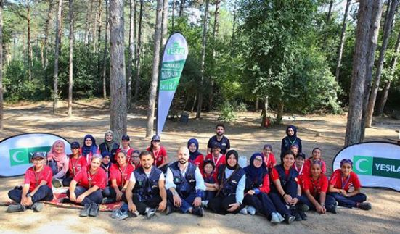
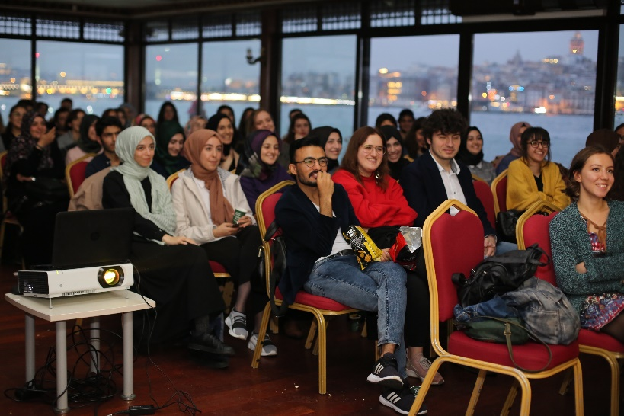
Green Crescent Youth
30 Thousand Young Volunteers
120 University Clubs
Youth Camps, historical city sightseeing, cinema nights and more…

Slide 5

United Nations for Youth
Awareness of the global situation of youth
Promote national youth policies, national youth coordinating mechanisms and national youth programmes of action as integral
Strengthen the participation of youth in decision-making processes

Slide 6

What is the Un Youth Forum?
UN Youth Forum is an international platform regarding Sustainable Development Goals where young from all around the world can contribute to policy discussions at the United Nations through their collective ideas; solutions and innovations.

Slide 7
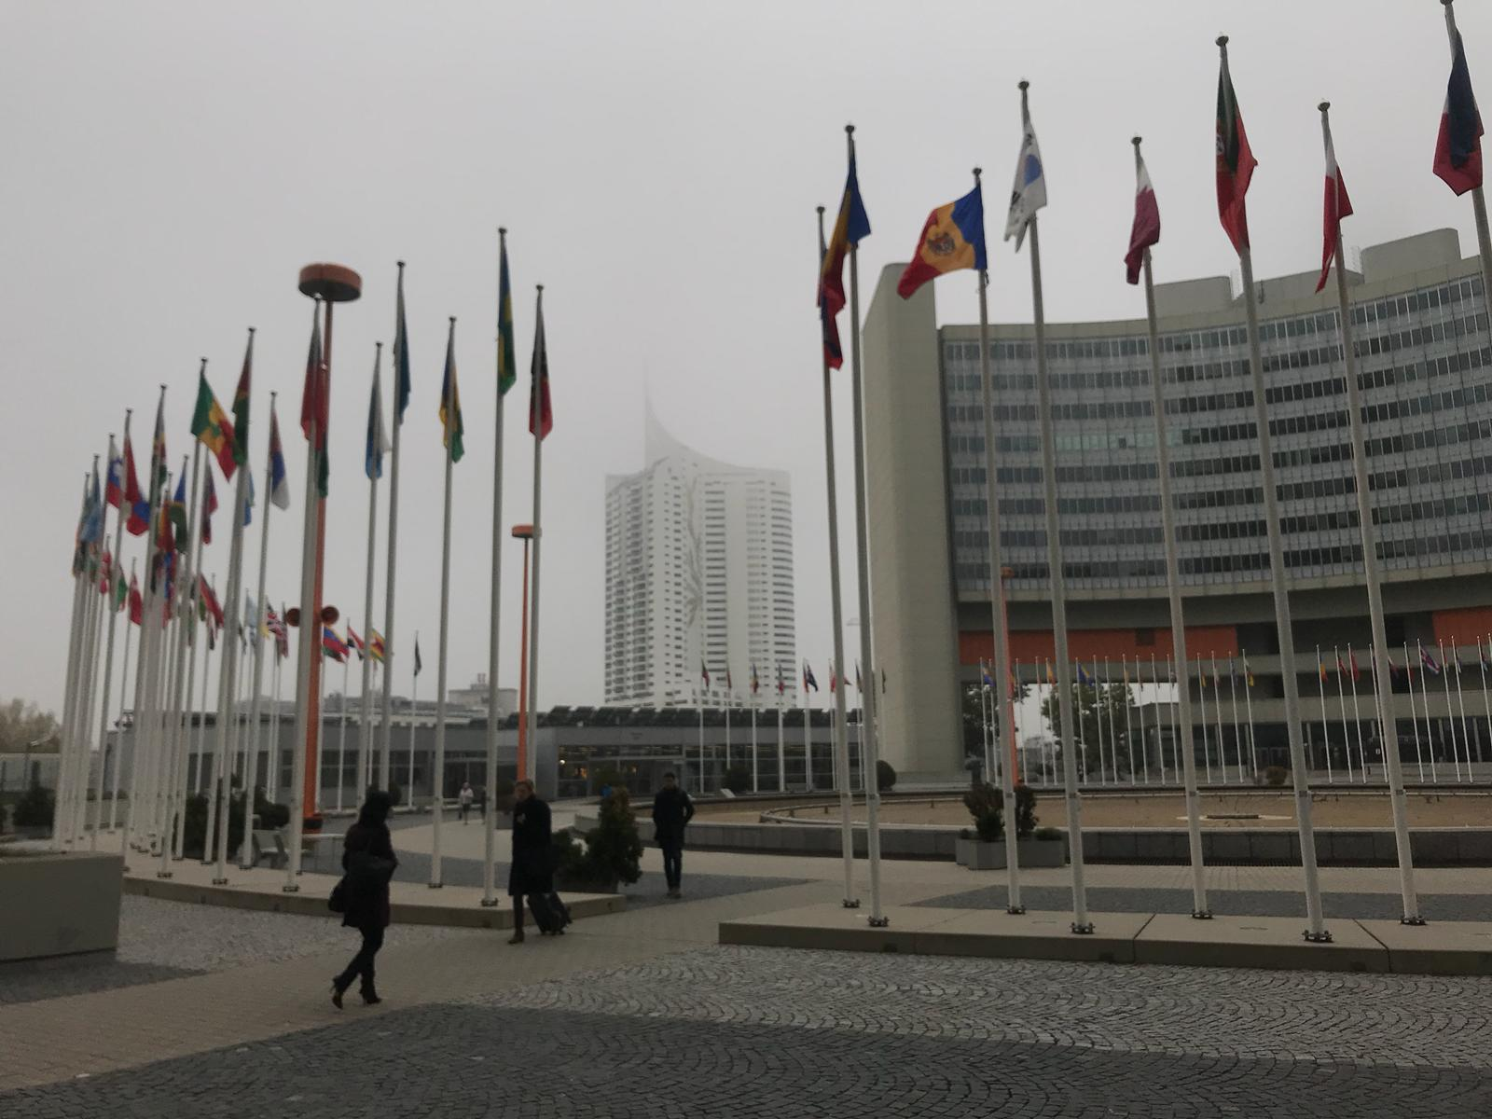
Our Journey to Vienna
Being informed by our school counselor and being a volunteer in Green Crescent
Interviews and elimination process nationwide
Our application to UNODC Youth Forum and further interviews
Time to prepare!
Participating in UNODC Youth Forum

Slide 8
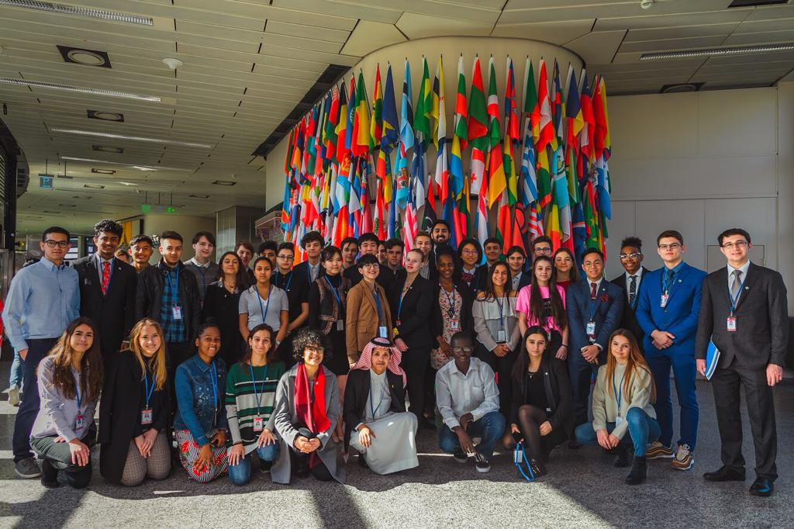

Slide 9
About the Forum
Providing youth motivation, engagement and colloration regarding prevention systems
What is prevention?
Group work about reasons, consequences and solutions for the usage of narcotic substances
Drafting the final document
Presenting the final document to 62nd session of the Commission on Narcotic Drugs (CND)

Slide 10
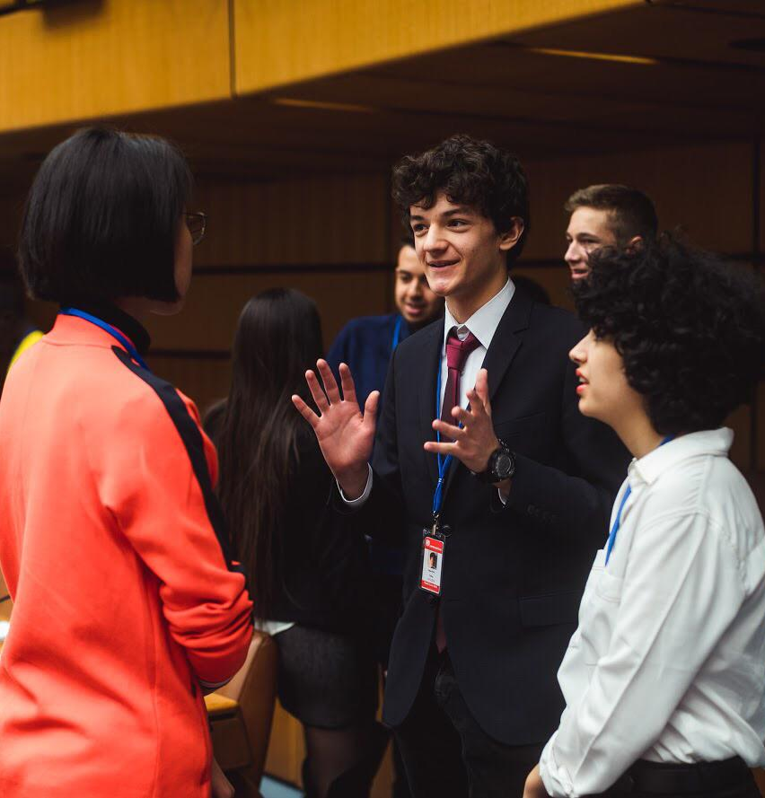
Achievements
Improving public speaking and discussion skills
Interactive and collaborative groupworks
Cultural integration
Having a better understanding of UN
Being able to share our national policies and our ideas in an international platform and representing Green Crescent

Slide 11
THANK YOU.

