Slide 1
Epidemiological foundations of gambling policy.
Lecture
4th Capacity Buildibg Program of Green Crescent, Istanbul, 5 December 2019
Pekka Sulkunen
Prof. Emeritus
CEACG, Department of Social Research
University of Helsinki

Slide 2
Background and the questions
Global gambling as measured by the Gross Gambling Revenue (the amount of money that operators collect after gamblers’ winnings are paid out) has doubled since about 2000 and expected to exceed 400 billion EUR very soon.
How is this associated with gambling-related burden of disease and other harmful consequences in populations?
Can harm be prevented?
What are the effective and cost-efficient means to do that?

Slide 3
Global growth of gambling 2003-2022 in million EUR

Slide 4
Figure 3.1. Annual Gross Gambling Revenue (GGR) in million EUR
by global regions between 2003 and 2022. Figures for 2018 - 2022 are estimates.
Courtesy of H2 Global Gambling Capital.

Slide 5
Figure 3.2. Gross Gambling Revenues (GGR) in EUR per resident adult (average losses)
by type of game in 2017 in 17 countries.
Courtesy of H2 Global Gambling Capital.

Slide 6
Loop One: public problems and public costs
Gambling
Problems
Costs, BoD
Need for regulation
?

Slide 7
Loop Two: dependencies on the ”rent”
Gambling
Public revenue
States, service providers (NGOs etc)
Resource needs (quality & availability of services)
Pressure to promote

Slide 8
Theory: The total consumption model (TCM)
Focus on consequences, no judgement of gambling itself (moral, religious, normative)
Applied in alcohol policy since the 1970s
General population, not problem users or individuals
Risk factors: person, context, environment (supply)
Treatment, early intervention and prevention

Slide 9
Theory: the total consumption model (TCM)
THREE ELEMENTS
The single distribution theory: a small fraction of users ( ca 2%) consume most of the total consumption (50%) in gambling: concenration is higher than in alcohol.
  if non-problem gamblers incerase/decrease their use,heavy users and the total consumption will follow, and vice versa
2) Consumption and harm: Overall level of harm follows from the overall level of consumption
3) Availability theory: Regulation of availability can influence total consumption and level of harm

Slide 10
TCM 1: Single distribution. Consumption follows a continuous skewed distribution with a high degree of concentration

Slide 11
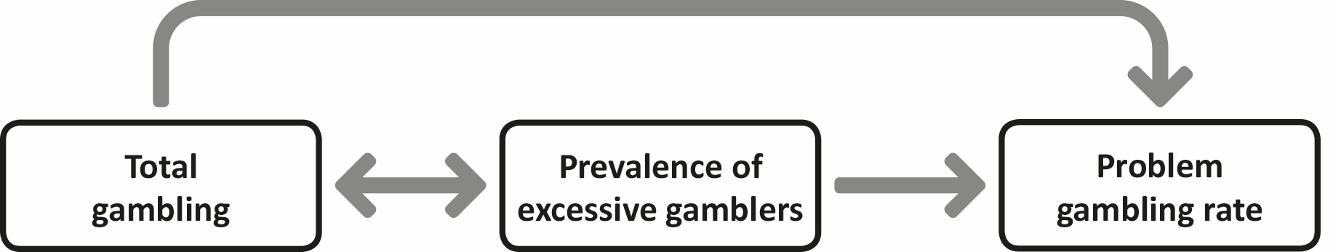
TCM 2: harm in the population is related to consumption
.

Slide 12
TCM 3: Availability theory: regulation influences consumption and affects harm also directly
regulation
consumption
harm

Slide 13
TCM 1-2-3 applied to gambling
Single distribution: solid evidence, except that the high end of the distribution involves high turnover
Harm: problematic to show causality for co-morbidities (substance use, mental health, physical health, suicide risk, poverty, crime)
Availability regulation: problematic to show causality because of other changes in the context, population mix, games and environments; price of the game is ambiguous, substitution and complementarity effects in game mix are not well known

Slide 14
TCM Version 1: Single Distribution theory and heavy gambling
Solid support for the skewed distribution and high concentration of gambling consumption (Govoni, 2000; Grun and McKeigue, 2000; Lund 2008; Hansen and Rossow 2008; Hansen and Rossow 2012)
A small fraction of gamblers account for a very large fraction of all gambling activities and of all gambling expenditures (eg. Chipman et al. 2006; Williams and Wood 2004; Livingstone and Woolley 2007
High turnover at the heavy end
Men, working age spend more money
Regular participation (esp lotteries) incrases with age
Poker & online more popular among the young
High and middle income groups spend more but poor gamblers spend a larger share of their income
Low income groups spend more on lotteries and other low risk games

Slide 15
TCM Version 2: prevalence of problem gambling -1
Harm theory works but cannot be limited to Problem Gambling or Gambling Disorder
Very small prevalence rates
  varying across populations and in time from 0.5% to 7.6%
  cross-country average of 2.3% of the population (smaller than for alcohol or drugs)
Variable individual level risk curves
  no J-curves (cf. alcohol);
  r-curves frequently observed;
  linear curves are also common
  Estimated 7 to 15 other people besides the gambler are affected

Slide 16
Tcm version 2: Comorbidity -3
Half of the revenue from gambling comes from a very small minority of heavy gamblers (1 to 2 percent of the population) (verified)
About half of this group have one or more of the following
  Poverty
  Mental health problem
  Suicide risk
  Physical health problem
  Substance use problem
  Criminal record
  causal sequencing is not (?) the key issue!
  Estimated 7 to 15 other people besides the gambler are affected

Slide 17
TCM Version 3: Availability theory
Increased availability increases demand and consumption
Decreased availability decreases demand and consumption
Confounding factors
  Few studies
  Other changes in the context and population mix
  Changes in games and environments
  The price factor is hard to estimate
  Sutbstitution/complentarity relations are not well known
Concusion on the basis of available evidence: availability matters but it is a complex variable and its effects are hard to measure

Slide 18
Problems with causal evidence
Definition and measurement of behaviours
Definition and measurement of problems: low rates of help-seeking
Low prevalence rates, low reliability in population surveys, high fluidity
Co-morbidities and adjunct problems
Policy effects cannot be distinguished from other factors unless they are dramatic

Slide 19
Preventing Gambling-related problems: further complexities
Variety of practices, motivations, meanings, norms and rules
No single ”molecule” to regulate: game features, environments, contexts
Consuming imaginary goods: hopes, (magic) beliefs, excitement, sociability (?) → thin line between legitimate ”customer experience” and deception
Money as a social bond: harm to others
Circulation of money: the ”rent” and the Two Loops

Slide 20
Policy potential: the flipside of industry strategies
Marketing
Game features
Gambling environments

Slide 21
Industry strategies 1: Marketing
  Substantial volumes in some countries (UK, Finland) and on some internet sites
  Huge jackpots (>10 million EUR) attract gamblers
  ”Good causes” in the service of marketing

Slide 22
Industry strategies 2: Game features
Increasing intensity (well known factors):
  1. Speed, small frequent wins, losses disguised as wins (LDW), progressive jackpots
  2. Sound, other sensory effects, fake interactive features (game controls)
  Seeking a balance between intensity, time on device and spending money:
    speed, bet size, jackpot size, return percentages

Slide 23
Industry strategies 3: venue characteristics to attract play
Strong evidence on:
  access to cash,
  no daylight or clocks,
  inducements,
  alcohol and smoking
Inconsistent or still insufficent evidence on
  Soundscapes
  Interior color or lightning
  Merging different forms of games (eg virtual betting; social gaming and gambling)
  )

Slide 24
Regulating 1: marketing
  The same debates about effectiveness as on other areas of advertising to general populations
  Distinctions between misleading and suggestive content are difficult to make
  What works:
  Huge jackpots are marketing techniques for media visibility and can be regulated (but seldom are)
  Regulations to protect children, less frequently other vulneralble groups, can be effective
  Unspecific (counter)information campaigns do not work

Slide 25
Regulating 2: game features
EVIDENCE SUPPORTS:
High speed, high and progressive jackpot size, losses disguised as wins (LDW) are always bad and can be regulated
Sensory effects, fake interactive features, other misleading skill enhancers are known for their effects and can be regulated to reduce harm
Limits on maximum spending or losses per hour, day, week or month are frequently applied and often work if sufficiently low
Protective rules on payments, frequent mandatory pay-outs and credit displays in real money are effective techniques to improve loss awareness and can be implemented
LESS CERTAIN ABOUT THESE:
Limiting bet sizes may reduce gambling but also increase it
The balance sought by operators between intensity, time on device and spending money is often beyond the reach of regulators

Slide 26
Regulating 3: gambling environments
EVIDENCE SUPPORTS:
Access to cash can be regulated to prevent problem gambling
Smoking and drinking in gambling venues can be regulated to prevent problem gambling and other related harm
Time awareness tools (daylight, clocks) in venues can be required to reduce problem gambling and other harm
Inducements (free drinks, meals, games) can be regulated to reduce harm
LESS CERTAIN ABOUT THIS:
Venue designs are carefully planned by operators but public evidence is thin about the effects of regulating them

Slide 27
Regulating 4: Pre-commitment tools
Pre-commitment tools help consumers to avoid excess by setting limits on the amount of spending, offering possibilities of self-exclusion and inervening when problem behavior is detected.
EVIDENCE SUPPORTS:
measures that are universally applied,
mandatory,
based on behavior, not self-assessment
sufficiently low limits,
implemented with personalized registration across all the accessible forms of gambling participation
intervention skills are assured and maintained by continuous development and training

Slide 28
Regulating industry strategies: CONCLUSIONS
MEASURES THAT WORK AND CAN BE IMPLEMENTED:
Marketing regulations to protect specific populations (children, problem gambling) work. Huge jackpot sizes work as marketing devices and can be regulated .
Game features: speed, LDWs, fake interactive features, progressive jackpots, sensory effects and protective payment rules can be regulated to mimimize harm
Venue characteristics that can be regulated to minimize harm include access to cash, smoking and drinking, inducements, time awareness features
Pre-commitment tools: may work if mandatory, universal, behavior-based, sufficient, cross-cutting, and supported

Slide 29
Recommendations: the burden of harm
The escalation of the industry generates its own momentum and is difficult to reverse.
Problem gambling has elements of addiction and a psychiatric disorder, but these are not the causes of its consequences. Social and environmental considerations are critical in the prevention and remediation of gambling problems in society.
Gambling transfers money from players to operators, governments, and ‘good cause’ beneficiaries. Policy should always take into consideration the distribution of costs and benefits between different groups of players and other actors

Slide 30
conclusions
1. Redistribution of wealth, concentration of the cost on a very small fragment of the population, and reinforcement of other vulnerabilities make gambling policy an issue of distributive justice.
2. Health inplications include Gambling Disorder and several co-morbidities, notably addictions, mental healt issues, suicide and stress-relöated problems. All require medical attention, treatment, and suppport services.
3. More than in other health related behaviours, medical attention, treatment and support services function as prevention of further damage.
4. Game characteristics and environmental features that induce problem gambling are well known and can be regulated

Slide 31
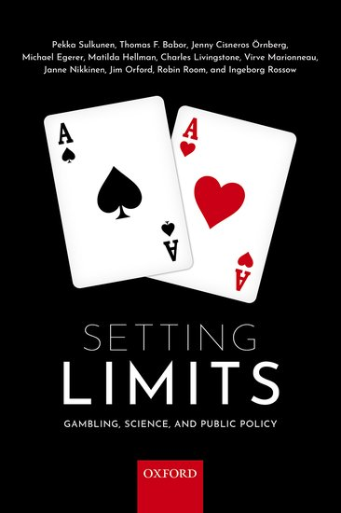
Authors:
  Pekka Sulkunen, Thomas Babor, Jenny Cisneros Örnberg, Michael Egerer, Matilda Hellman, Charles Livingstone, Virve Marionneau, Janne Nikkinen, Jim Orford, Robin Room, Ingeborg Rossow
Foreword: Dr. Vladimir Poznyak
  Financial Support:
    The Academy of Finland, The Finnish Foundation for Alcohol Studies, The Swedish Research Council for Health, Working Life and Welfare (Forte), and the institutions of participant authors

Slide 32
THANK YOU!

Slide 33
TCM Version 2: prevalence of problem gambling -2
Population level burden of harm
  most likely to follow a linear pattern
  this is not always observed in studies of change
Confounding factors at the population level
  small frequencies → high likelihood of measurement errors
  unrecored consumption
  game mix may change (substitution)
  population mix may change (abstainers/heavy)
  ”adaptation” (people get used to exposure)
  saturation (the population reaches an upper limit)
  high fluidity of the problem gambling population
Estimated 7 to 15 other people besides the gambler are affected

Slide 34
NORWAY 2006-2011: Number of help line calls per half year by year and main problem game
K NOTE ACCEPTOR
BAN BANK NOTE ACCEPTOR, JULY 1ST
BAN ALL EGMS, JULY 1ST
BAN NIGHT TIME EGM GAMBLING, JANUARY 1ST
INTRODUCTION NEW EGMS, MAINLY THROUGHOUT 2009

Slide 35
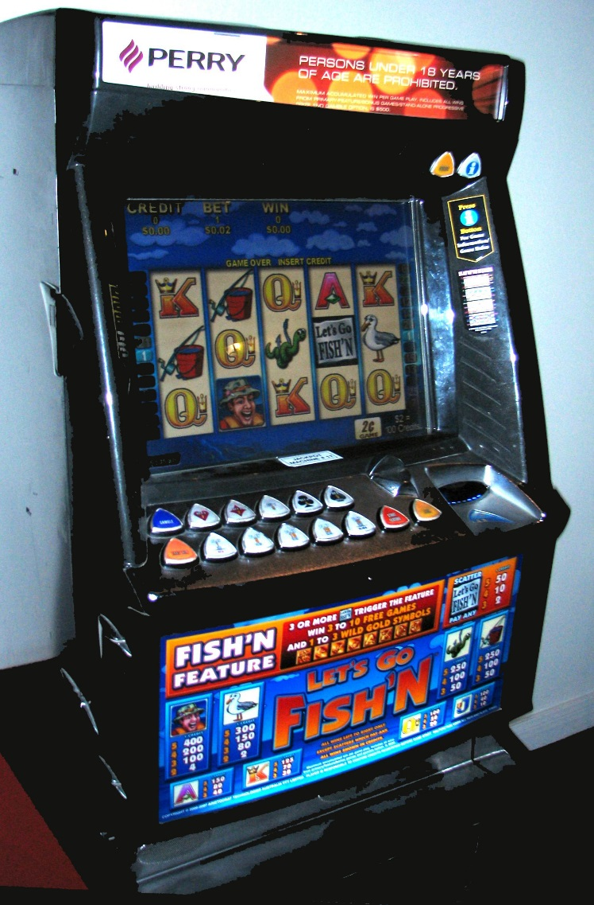
New Zealand pokie machine

Slide 36
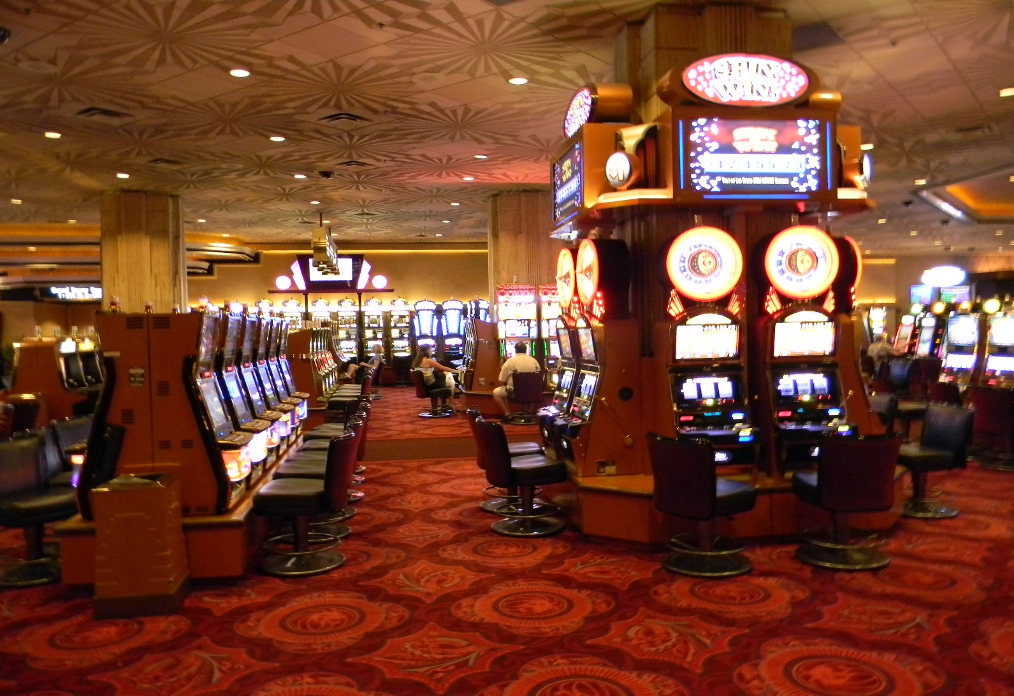
Casino interior

Slide 37
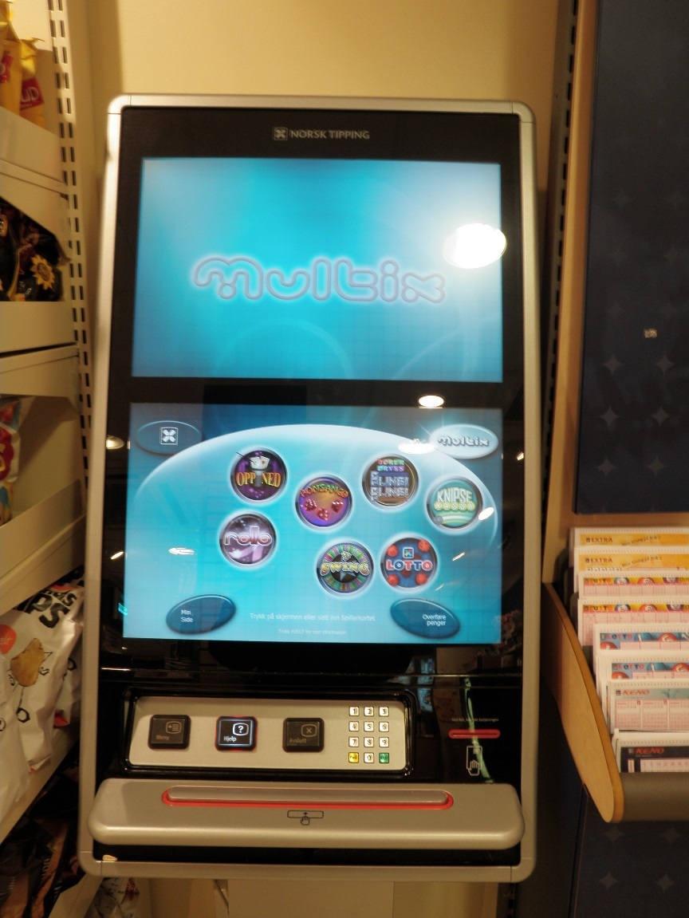
Norwegian Multix EGM

Slide 38
Table 7.2. Impact studies of reduced availability of gambling machines.
COUNTRY | AVAILABILITY CHANGE | YEAR | OUTCOMES | REFERENCES | OBSERVATIONS
NORWAY | Temporary EGM prohibition; afterwards Norsk Tipping monopoly | 2007 | Problem gambling prevalence; differing results depending on measurement, but problem gambling help seeking decreased | Rossow and Hansen 2015 ; Lund 2009 | Combined with EGM modifications, removal of note acceptors, personal identification card
SWITZERLAND | Gambling machines outside casinos prohibited | 2005 | No decrease in problem gambling, but clear reduction of problem gamblers with probable alcohol problem | Bondolfi et al. 2008 | Same time permission to open 19 casinos
US | Temporary ban of EGMs in South-Dakota | 1994 | Significant decrease of visits to problem gambling treatment facilities | Carr et al. 1996 | Ban lasted only three months
US | Ban of EGMs in South-Carolina | 2000 | Number and size of Gamblers Anonymous groups decreased | Bridwell and Quinn 2002, Williams et al. 2012b | Demand for help with problem gambling remained low in later years as well as during the ban.

Slide 39
Regulating industry strategies: CHALLENGES
Industry strategies have multiple goals and seek a balance between them
Some strategies are beyond the reach of regulation (integrating gaming and gambling, variations in game features and venue characteristics according to market conditions)
Mobile gambling on hand-held devices is the growing market and requires international regulation
Game offer is a complex whole: effects of single factors or features or regulations on these are difficult to identify
There is a need to develop composite indicators (CI) for evaluating industry strategies and for assessing their effects on gambling related harm

Slide 40
Public health and public interest: continuities and a new perspective
Continuities:
populations, not individuals
(health) consequences, not behaviour (drinking, gambling, drugs)
priority in prevention; treatment as secondary (risk levels, brief interventions) and tertiary prevention
emphasis on regulation of demand and supply (”availability theory”)
New perspective:
«Redistribution of wealth, concentration of the cost on a very small fragment of the population, and reinforcement of other vulnerabilities make gambling policy an issue of distributive justice.«

Slide 41
Recommendations: bearing the burden
A very small part of the population and of those who gamble account for a very large share of the total spending. Effective preventive policy will have to accept that it most likely also reduces the total volume of the trade.
Problem gambling co-occurs frequently with mental and physical health problems, substance use, smoking, poverty, family problems, suicide risk, and criminal records. The direction of causality cannot always be determined, but collateral damage should be considered in regulating and in providing help to those who suffer from their own or other persons’ gambling.

Slide 42
Recommendations: regulating availability
The harm to society varies with the total amount of money and time spent on gambling. Game features and gambling environments have different potentials for harm and different capacities to collect money from players.
Simple prevalence measurements of problem gambling should be interpreted cautiously and should not be used as the basis of policymaking.
The individual problem gamblers change from one period to the next, and the number of other persons affected by one problem gambler can be high.

Slide 43
Recommendations: limit-setting and pre-commitment
Effective evidence-based techniques for preventing gambling-related harm exist and can be implemented. These include setting limits to game intensity, sensory effects, inducements, smoking and drinking and access to cash, whereas information, persuasion, self-assessment and other personality-based responsible gambling tools have not been shown to be effective.
Effective pre-commitment and limit setting tools are those that are universally applied, mandatory, based on behavior, and implemented with personalized registration across the accessible forms of gambling participation.
Government revenue and funding towards good causes from gambling create dependencies that may pressure policymaking. Gambling regulation should be separated from both of those interests.
Regulation of online gambling is possible and is to be recommended as a harm-reduction policy.
An international agreement on gambling control needs to be negotiated. The need for international control of online gambling makes this an urgent issue.

Slide 44
conclusions
Redistribution of wealth, concentration of the cost on a very small fragment of the population, and reinforcement of other vulnerabilities make gambling policy an issue of distributive justice.

Slide 45
Contents
6 The total volume of gambling and the prevalence of gambling problems
7 The effects of changing availability
8 Industry strategies and their regulation: marketing, game features, and venue characteristics
9 Pre-commitment and interventions in risk behavior
10 Gambling control regimes
11 Treatment and early intervention services
12 Summary and conclusions: gambling policy and the public interest
Foreword by Dr Vladimir Poznyak, WHO
1 Introduction
2 The history of gambling regulation and the rise of the industry
3 The gambling industry: global structures and modern trends
4 The range and burden of gambling problems
5 Gambling behavior and problem gambling

Slide 46
Co-authorship involves:
Consensus report
Shared starting point: The Total Consumption Model (TCM) → The Public Health Approach
Each book conributes a new perspective, theoretical or empirical
  Bruun et al 1975: TCM epidemiological foundations
  Mäkelä, Room & Sulkunen 1980: historical policy context
  Edwards et al 1994: The prevention ”paradox”
  Babor et al 2003: Evidence on policy implications (availability theory)
  Babor et al 2018 (2nd ed): Limits to limits on drug use
  Sulkunen et al 2019: Public interest vs public health

Slide 47
The Public Interest Approach
A. Concrete recommendations, not abstract principles
B. Justifying and evaluating policies in variable contexts, not ”patent medicins”
C. ”Realizations”, not not only measuring the burden of harm
D. Focus on policy itself, not only on its effectiveness and cost efficiency
1. Agencies and actors
2. Capabilities
3. Processes
4. Intentions

Slide 48
Table 3.1. Number of Electronic Gambling Machines (EGM) in different countries and persons per machine in ten countries with the world’s biggest EGM market in 2016
Jurisdiction/rank | Number of EGMs | Persons/machine
1. Japan | 4,575,545 | 28
2. Australia | 197,122 | 122
3. Italy | 456,367 | 132
4. Spain | 212,153 | 219
5. Germany | 277,325 | 298
6. Canada | 98,902 | 369
7. US | 865,807 | 373
8. UK | 167,839 | 391
9. Argentina | 98,717 | 444
10. Mexico | 90,000 | 1,417
Data sourced from Ziolkowski S. The World Count of Gaming Machines (2016) the Gaming Technologies Association http://gamingta.com/wp-content/uploads/2016/10/World_Count_of_Gaming_Machines_2015.pdf.
Source: Ziolkowski 2017. Population statistics: World Bank 2017

Slide 49
Table 5.1. Percentage of adults participating in different types of gambling in the past year, and percentage of participants doing so weekly or more often. The United Kingdom, 2010
Gambling mode | Percent involved in last year | Percent of population participating weekly or more often | Percent of those involved in last year who participate weekly or more often
National Lottery Draw | 59 | 36 | 61
Another lottery | 25 | 5 | 20
Scratch cards | 24 | 6 | 25
Slot machines | 13 | 2 | 15
Horse races | 16 | 3 | 19
Bingo | 9 | 3 | 33
Private betting | 11 | 2 | 18
Any online gambling | 11 | 5 | 45
Any gambling | 73 | 43 | 59
Source: Adapted from Wardle et al. 2011a

Slide 50
Why the poor play more?
High income inequality –> more gambling (partly verified)
Economic downturns increase the inequality-effects of gambling → low income elasticity (verified)
Unawareness of odds → low price elasticity (verified)
Anxiety and stress (partly verified)
Aspirations for access to consumer goods (partly verified)
Low income groups have few possibilities to advance their position (hypothesis)
Lacking cognitive abilities (partly verified but dubious)

Slide 51
Table 10.1. Importance of public gambling revenue in selected jurisdictions compared to the state budget
Jurisdiction | Public revenue gambling compared to state budget* (percent) | Year | Source
AUSTRALIA | 7.8 | 2015 | Australian Gambling Statistics 32nd edition, 2016
- Victoria | 9.6 | 2015 | (percent of state revenue) Australian Bureau of Statistics, 2016
- Western Australia | 2.6 | 2015 | (percent of state revenue) Australian Bureau of Statistics, 2016
CANADA (average) | 2.2 | 2013 | Responsible Gambling Council, 2015
- Alberta | 3.5 | 2013 | Responsible Gambling Council, 2015
- British Columbia | 2.7 | 2013 | Responsible Gambling Council, 2015
- Ontario | 1.7 | 2013 | Responsible Gambling Council, 2015
- Québec | 1.2 | 2013 | Responsible Gambling Council, 2015
FINLAND | 2 | 2016 | Contributions of the gambling monopolies to charities, sports and culture, and gambling taxes compared to state budget.
FRANCE | 1.7 | 2015 | Cour des Comptes, 2016
GERMANY | 1.6 | 2012 | Total public gambling revenues (Fiedler 2016a ) compared to federal state budget.
 | 0.8 | 2012 | Total public gambling revenues compared to federal and state budgets combined (our calculations)
Jurisdiction | Public revenue gambling compared to state budget* (percent) | Year | Source
ITALY | 2 | 2012 | Gandolfo and De Bonis, 2013
MACAU | 40 | 2011 | Huang, 2011
NORWAY | 0.6 | 2016 | Contributions and taxes of Norwegian gambling monopolies compared to state budget.
SWEDEN | 1.8 | 2016 | Contributions and taxes of licensed gambling companies and NGOs compared to state budget (Lotteriinspektionen, 2015).
UNITED KINGDOM | 0.5 | 2014 | Our calcuation compared to state budget.
UNITED STATES (average) | 2.3 | 2006 | Dadayan et al., 2008
- Nevada | 13.4 | 2006 | Dadayan et al., 2008
- West Virginia | 8.9 | 2006 | Dadayan et al., 2008
- New Jersey | 3.8 | 2006 | Dadayan et al., 2008
- Illinois | 4.0 | 2006 | Dadayan et al., 2008
- New York | 2.9 | 2006 | Dadayan et al., 2008
- California | 0.9 | 2006 | Dadayan et al., 2008

Slide 52
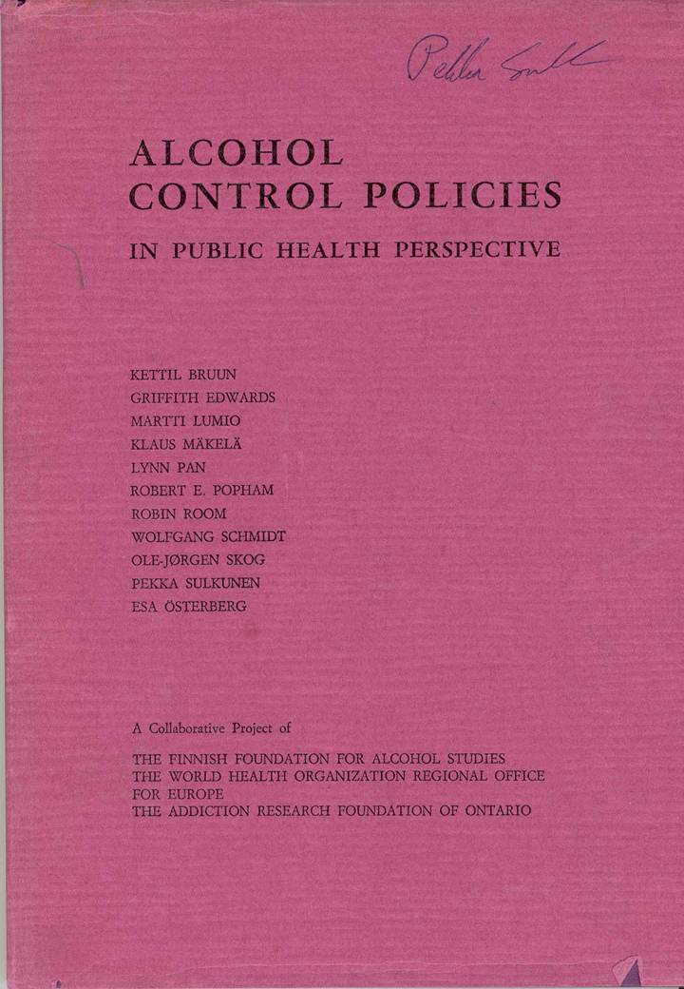


Slide 53


Authors: Klaus Mäkelä, Robin Room, Eric Single, Pekka Sulkunen and Jan de Lint (1980)
Editors: Eric Single, Patricia Morgan and Jan de Lint (1981)

Slide 54



Slide 55


Slide 56
Objectives and methods
Objective: state of the art
to determine what kinds of issues for public interest arise from gambling
to determine how PG (problem gambling) is related to the total amount of gambling
to determine what kinds of policies and ”responsible gambling” tools are effective and cost-efficient
Methods:
systematic review of research literature
about 2300 studies consulted
721 references, about 70 % presenting original research or systematic reviews
critical collective assessment of evidence
summary statement highlighting major concerns and recommendations
- to

Slide 57
Table 6.1. Overview of studies addressing the total consumption model with respect to gambling
 | Non-gamblers included in analyzes | Cross-sectional or longitudinal comparison | Association of total gambling and prevalence of excessive gambling | Association of total gambling and prevalence of problem gambling
Govoni, 2000 | No | Cross-sectional | Mean expenditures - % spending > 3000 CAD (adj R²= .66) Mean expenditures - % > 15% family income (adj R²= .80) | Mean expenditures - % SOGS score 5+ (adj R² = .83)
Grun and McKeigue, 2000 | Yes | Both | Mean expenditures - % > 20 GBP/week (regr coeff 1.6) Mean expenditures - % > 10% household income (regr coeff 1.2)
Lund, 2008 | Yes | Cross-sectional | Mean gambling frequency - % frequent gamblers (clear positive relationship, not quantified)
Hansen and Rossow, 2008 | Yes | Cross-sectional | Mean expenditures on EGMs - % high expenditures (r=.73, r= .57) Mean gambling frequency - % weekly gamblers (r=.90; r=.83) | Mean expenditures on EGMs - % LieBet score 2 (r=.63; r=.60) Mean gambling frequency - % meeting various DSM-criteria (r=.52; r= .47; r= .33)
Hansen and Rossow, 2012 | No | Longitudinal | Mean gambling frequency – percentiles of gambling frequency (50th, 75th, 90th, 95th): clear positive relationship, not quantified
Abbott, 2006 | Not clear | Cross-sectional |  | Mean EGM expenditures - % SOGS 5+: positive relationship, not quantified
Markham et al., 2014 | No | Cross-sectional |  | Mean expenditures on EGMs - % PGSI 2+ (r =.27)

Slide 58
Table 5.2. Prevalence of comorbid disorders in problem and pathological gamblers
Comorbid disorder | %
Major depression | 23.1
Bipolar disorder/manic episodes | 9.8
Any anxiety disorder | 37.4
Generalized anxiety disorder | 11.1
Any mood disorder | 37.9
Antisocial personality disorder | 28.8
Substance use disorders | 57.5
Nicotine dependence | 60.1
Source: Lorains et al. (2011)

Slide 59
Table 4.1. Financial gambling-related harm reported by non-problem gamblers, problem gamblers, and problem gamblers in counseling.
Financial harms from gambling | % Non-problem gamblers | % Problem gamblers (SOGS 5+)¹ | % Problem gamblers in counseling (SOGS 5+)¹
Owed money to pay for gambling | 4.6 | 51.4 | n/a
Borrowed money without paying back | 0.7 | 18.7 | 53
Borrowed from loan sharks | 0.1 | 5.8 | 8.4
Declared bankruptcy | 0.03 | 1.4 | 8.4
Sold property to gamble | 0.3 | 10.8 | 36.7
Lost a house | n/a | n/a | 7.9
Used pawnbrokers to get funds to gamble | 0.5 | 13.1 | n/a
1 SOGS 5+ means a score of 5 or more on the South Oaks Gambling Scale (see Chapter 5), which is indicative of problem gambling.
Source: Productivity Commission (1999).

