Slide 1
CIVIL SOCIETY and THE UN
Vienna NGO Committee on Drugs &
UNODC Civil Society Team

Slide 2
WHO ARe we?
VNGOC
VNGOC was established in 1983
Links NGOs with the Vienna-based drug control agencies
Open to all drug policy NGOs – currently around 230 members
Broad spectrum of views and experiences
Close collaboration with UNODC (Memorandum of Understanding)
Run by a Board of 6 elected by member organisations

Slide 3
What we DO
VNGOC
promoting collaboration with the relevant international agencies
advocating for NGO inclusion in international drug policy decision making
disseminating information and news
supporting engagement in Vienna
facilitating the representation of NGOs, e.g. through speaker selection
organising “informal dialogues” with key figures
representing a global NGO voice at key strategic events

Slide 4
MEMBER ORganisations
VNGOC

Slide 5
How to become a VNGOC member organisation
VNGOC
Go to http://vngoc.org/about-the-vngoc/membership
Fill out the application form and register at UN-DESA (https://esango.un.org/civilsociety/consultativeStatusSummary.do?profileCode=636274)
After review from the board you’ll receive your welcome package

Slide 6
THE Marketplace - www.mp.vngoc.oRG
Joint project of UNODC and VNGOC
NGOs can present their work,
exchange expertise,
network and
raise awareness about their work in the field of drug policy
Share their event in a global calendar
Go to www.mp.vngoc.org and create a profile

Slide 8
2-6 March 2020 in Vienna, Austria
63rd Commission on Narcotic Drugs

Slide 9
What is CND?
63rd CND
a „functional commission“ of ECOSOC
principal policy-making body within UN drug control system
53 Members but all Member States participate
decisions and resolutions by consensus or vote
Upon WHO recommendation, the CND schedules narcotic drugs and psychotropic substances
Upon INCB recommendation, the CND puts precursor chemicals frequently used for the manufacture of illicit drugs under special control

Slide 10
How does it work?
63rd CND
Annual main session in March and reconvene session in December
Plenary and Committee of the Whole (CoW)
Intersessional Meetings
Working Groups
Informal Meetings

Slide 11
How to Engage at the CND
63rd CND
NGOs with ECOSOC status may send up to 10 observers
NGOs without ECOSOC status need to ask either other NGOs or governments to be on their delegations
Make statements in the Plenary
Meet with government delegations
Organise or present at side events
Put documents on the NGO table or organise your own exhibition
Join VNGOC
Attend our Informal dialogue sessions

Slide 12
Side Events
63rd CND
Mornings and lunchtimes – more than 100 last year!
Organised by member states, UN agencies and/or NGOs
Application Period: January 6th - 17th 2020 (http://vngoc.org/2019/11/19/side-events-at-cnd-2020/)
Space for more in-depth debate on key issues
Anyone can make interventions

Slide 13
Other Meetings during the 63rd CND
63rd CND
NGO briefing (VNGOC and UNODC Civil Society Team) on Monday morning
Informal Dialoges with:
UNODC Exec. Director
INCB President
CND Chair
VNGOC Annual General Assembly on Wednesday afternoon
VNGOC Social Gathering Wednesday evening

Slide 14
ECOSOC Consultative Status
ECOSOC Consultative Status
General, Special, Roster
Provides access to ECOSOC and its subsidiary bodies e.g. CND
Deadline for applications to be reviewed the coming year is June 1st

Slide 15
Requirements
ECOSOC Consultative Status
Activities are relevant to ECOSOC
NGO has been officially registered and has existed for at least two years
NGO must have a democratic decision making mechanism
Majority of funds should come from contribution from affiliates, individual members or other non-governmental sources

Slide 16
Application Process
ECOSOC Consultative Status
Set up profile on the UN DESA platform
Complete online application form in English or French
Upload required documents in original language and English or French translation

Slide 17
… And the role of Civil Society

Slide 18
How did we get to The 2019 Ministerial Declaration?
Multiyear Work Plan (until 2023)
2019 Ministerial Declaration
Vienna
2016 UNGASS Outcome Document
New York
2014 Joint Ministerial Statement
Vienna
NGO Declaration
2009 Political Declaration and Plan of Action
Vienna
2019: target date

Slide 19
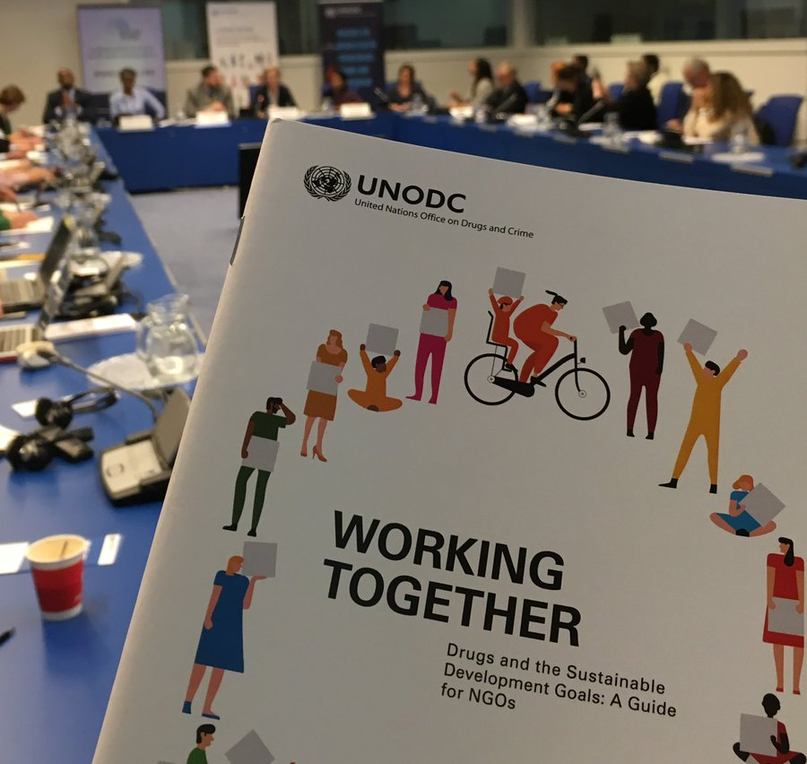
Text
Demand Reduction,
Access to medicine,
Supply Reduction,
Human rights,
Evolving Realities,
International Cooperation,
Alternative Development

Slide 20
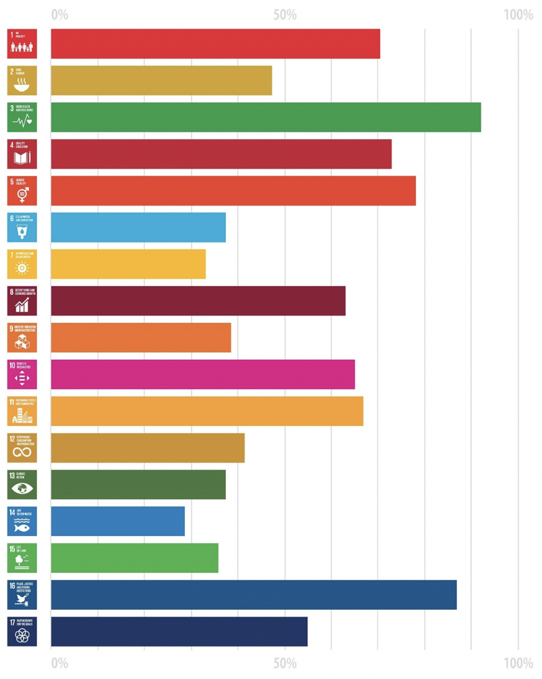
CSTF global consultation report: http://vngoc.org/2019/02/19/cstf-global-consultation-report/

Slide 21
Demand Reduction and Related Measures
2019 Ministerial Declaration
Member States reiterated their resolve, in the framework of existing policy documents, inter alia, to […] strengthen effective, comprehensive, scientific evidence-based demand reduction initiatives covering prevention, early intervention, treatment, care, recovery, rehabilitation and social reintegration measures on a non-discriminatory basis, as well as, in accordance with national legislation, initiatives and measures aimed at minimizing the adverse public health and social consequences of drug abuse.

Slide 22
AVAILABILITY OF AND ACCESS TO CONTROLLED SUBSTANCES
2019 Ministerial Declaration
Member States echoed their resolve to […] ensure access to and the availability of controlled substances for medical and scientific purposes, including for the relief of pain and suffering, and address existing barriers in this regard, including affordability. They also noted with concern persistent and emerging challenges related to the world drug problem, including that the availability of internationally controlled substances for medical and scientific purposes, including for the relief of pain and palliative care, remains low to non-existent in many parts of the world.

Slide 23
SUPPLY REDUCTION AND RELATED MEASURES
2019 Ministerial Declaration
In reaffirming their determination to address public health, safety and social problems resulting from drug abuse (Para 1.4) Member States also reiterated their resolve to prevent and counter illicit crop cultivation and the production, manufacturing of and trafficking in narcotic drugs and psychotropic substances, including synthetic drugs and new psychoactive substances. Member States further reiterated their resolve to work towards preventing, significantly reducing and eliminating the diversion of and illicit trafficking in precursors, and money-laundering related to drug-related crimes. (Para 11) In the framework of existing policy documents Member States committed to address socioeconomic issues related to illicit crop cultivation and the production and manufacture of and trafficking in drugs as well as to promote alternatives to or additional measures with regard of conviction and punishment in cases of an appropriate nature, in accordance with international treaties and national law.(Para 1.11)
As part of the Way Forward Member States commit to strengthening bilateral, regional and international cooperation and promoting information-sharing, in particular among judicial and law enforcement authorities. (Para 3.4)

Slide 24
HUMAN RIGHTS, YOUTH, CHILDREN, WOMEN AND COMMUNITIES
2019 Ministerial Declaration
Member States reaffirmed the commitment to a balanced, integrated, comprehensive, multidisciplinary and scientific evidence-based approach to the world drug problem, based on the principle of common and shared responsibility, and recognized the importance of appropriately mainstreaming a gender and age perspective into drug-related policies and programmes and that appropriate emphasis should be placed on individuals, families, communities and society as a whole, with a particular focus on women, children and youth, with a view to promoting and protecting health, including access to treatment, safety and the well-being of all humanity.

Slide 25
EVOLVING REALITY, TRENDS AND EXISTING CIRCUMSTANCES, EMERGING AND PERSISTENT CHALLENGES & THREATS
2019 Ministerial Declaration
Member States committed to strengthening the work of the Commission on Narcotic Drugs with the World Health Organization and the International Narcotics Control Board, within their treaty-based mandates, as well as with the United Nations Office on Drugs and Crime, to continue to facilitate informed scheduling decisions on the most persistent, prevalent and harmful substances, including synthetic drugs and new psychoactive substances, precursors, chemicals and solvents, while ensuring their availability for medical and scientific purposes, and commit to strengthening the dialogue of the Commission with the International Narcotics Control Board on the implementation of the three international drug control conventions, and with relevant international organizations.

Slide 26
INTERNATIONAL COOPERATION BASED ON THE PRINCIPLE OF COMMON AND SHARED RESPONSIBILITY
2019 Ministerial Declaration
Member States are dedicated to strengthening bilateral, regional and international cooperation and promoting information-sharing, in particular among judicial and law enforcement authorities, in order to respond to the serious challenges posed by the increasing links between drug trafficking, corruption and other forms of organized crime, including trafficking in persons, trafficking in firearms, cybercrime and money-laundering.

Slide 27
Alternative Development
2019 Ministerial Declaration
Member States reiterated their resolve to strengthen the implementation of long-term and comprehensive development oriented drug control policies and programmes in order to address drug-related socioeconomic issues related to illicit crop cultivation and the production of drugs. (Para 1.11) In the Way Forward Member States committed to increasing the provision of technical assistance and capacity building, in particular to those countries most affected by the world drug problem. (Para 3.6)

Slide 28
THE ROLE OF NGOs IN ADDRESSING THE MAIN ASPECTS OF THE WORLD DRUG PROBLEM IN LINE WITH THE 2019 MINISTERIAL DECLARATION
INTERACTIVE GROUP WORK
YOUR IDEAS AND PERSPECTIVES!
EXPRESS YOURSELVES

Slide 29
Activity 1 (15 minutes) – In your regional groups
Task1: Based on the summary you were provided, discuss and answer the following questions:
Which aspect of the 2019 Ministerial Declaration do you feel is/are be more relevant to the work of your NGO?
How can you put the provisions in practice (at least 5 activities you can carry out on the ground)?
Present your ideas on a flipchart

Slide 30
Activity 2 (15 minutes) – In your regional groups
What are the main challenges that you envisage in carrying out the activities related to the relevant provisions of the 2019 Ministerial Declaration? If you already do activities related to aspects of the 2019 Ministerial Declaration, what challenges do you face in carrying out these activities?
What opportunities do you see in the 2019 Ministerial Declaration for you and your NGO?
Which support would you need from: the government, local authority, other NGOs, UNODC, WHO in order to successfully carry out activities related to the 2019 Ministerial Declaration?

Slide 31
THANK YOU!
CONTACT Information
www.vngoc.org https://www.facebook.com/VNGOCondrugs/ twitter.com/theVNGOC
info@vngoc.org Sarah Pirker: spirker@vngoc.org

Slide 32
Resources
VNGOC: www.vngoc.org
CSTF: www.cstfondrugs.org
Results of the CSTF global online survey: https://www.cstfondrugs.org/online-consultation-2018/
NGO Marketplace: www.mp.vngoc.org
UNODC Civil Society Team: http://www.unodc.org/unodc/en/ngos/DCN0-NGOs-and-civil-society.html
63rd CND: https://www.unodc.org/unodc/en/commissions/CND/session/63_Session_2020/session-63-of-the-commission-on-narcotic-drugs.html
CND Blog: http://cndblog.org
WORKING TOGETHER: The 2019 Ministerial Declaration on Drugs and the Sustainable Development Goals: A Guide for NGOs: http://vngoc.org/wp-content/uploads/2019/12/ungass2019_16x24_28Oct2019.pdf
ECOSOC Applications: http://csonet.org/index.php?menu=34

