Slide 1
International Federation of Green Crescent (IFGC)
International Federation of Green Crescent (IFGC), which was founded in İstanbul on 7 November 2016, takes its intellectual foundations from the Turkish Green Crescent, the oldest and most established organization in the field of addictions across the world.
2006
International Federation of Green Crescent aims to become an exemplary organization in the field of tobacco, alcohol, drug, technology, and gambling addictions, and to support the work of other countries in combatting their prominent forms of addiction by sharing its century-old experience in the struggle with addictions.

Slide 2
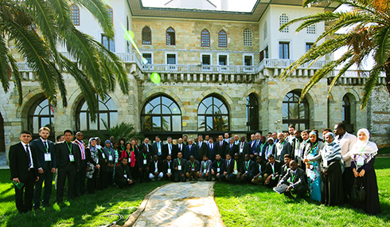
International Federation of Green Crescent (IFGC)
Within the scope of the Capacity Building Program with over 200 participants, issues such as determination of prospective visions of 70 member states of the International Federation of Green Crescent (IFGC) throughout the world, addiction prevention programs, pilot projects to be realized by countries, efficient benefit from the International Financial Support Program offered by Turkish Green Crescent Society, and development led by the State of the Republic of Turkey will be at the forefront.

Slide 3
International Federation of Green Crescents (IFGC)
Cyprus, Kyrgyzstan
Republic of Congo,
Serbia,
Sudan.
Indonesia, Morocco, Zimbabwe,
Ivory Coast,
Palestine, South Africa, Georgia, Iraq, Montenegro,
Kazakhstan, Kenya, Somalia,
Syria.
Afghanistan, United States, Albania, Australia,
Azerbaijan, Bangladesh, Bosnia and Herzegovina, Bulgaria, China, Dagestan, Pakistan,
Uganda, Greece, Turkey.
Senegal,
Singapore,
Yemen, Tanzania Kosovo, Lebanon, Macedonia.

Slide 4
10 VNGOC Members
Nigeria
Jordan
Albania
Afghanistan
Malaysia
Kyrgyzstan
Bosnia And Herzegowina
Morocco
Georgia
Turkey

Slide 5
17 ECOSOC Applications
1. Albania
2. Tanzania
3. Azerbaijan
4. Bosnia and Herzegovina
5. Australia
6. Indonesia
7. Kosovo
8. Georgia
9. Uganda
10. Congo
11. Somalia
12. Montenegro
13. Malaysia
14. Serbia
15. Bulgaria
16. Nigeria
17. Niger

