Slide 1

The Role of the Family in Prevention and Rehabilitation
Sultan ISIK
Turkish Green Crescent, CEO

Slide 2
Contents
What is prevention?
Effective strategies in the prevention of addictions?
Prevention and intervention techniques in addiction disorders?
The role of family in prevention and treatment?

Slide 3
Prevention
All activities and strategies that are developed to build a healthy and productive society can be referred to as preventative efforts
Notes:
Bu durum yalnızca madde için değil; alkol, telefon, bilgisayar veya herhangi bağımlılık için de geçerlidir.

Slide 4



Aims of Prevention
Aims of Prevention
To prevent people from developing addiction disorders
To prevent individual and social problems resulting from addictions
To support the development of healthy habits

Slide 5



Successful Prevention Strategies
Information: Informing people about addictions in an objective way.
Education: Teaching life skills, such as how to say no, developing coping mechanisms to be applied in stressful situations.
Creating Alternatives: Modifying the behavior of young people through different activities, with the aim being to show young people that there are better things to do than using substances.
Guidance: Detecting young people who have started using substances or who are at a high risk of starting to use substances. Guidance includes early intervention in young people.
Combatting: NGOs play a crucial role in combatting substance use. The aim is to apply prevention activities within an individual’s environment, including providing information and psycho-social support, and raising awareness.

Slide 6
The Role of the Family in Prevention

Slide 7

Tobacco Addiction
The reason of addressing cigarette as the primary addictive substance here is that cigarette is commonly used by people from all sections such as children, youth and elderly. Thus, the development of the policies of healthcare services and the attitudes of family units are very important in the prevention of this addiction.

Slide 8

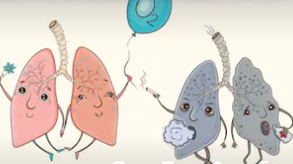
Effect of Family in Tobacco Addiction
As all kinds of substance use starts with curiosity and imitating, encouraging behaviors for tobacco should be avoided.
Children should be involved in organized activities such as school, sports, music, scientific research and projects.
Families should ensure taking educational precautions for the protection of youth against cigarette and young people should be directed to the education programs.
The family should consider the young person as an individual and should be supportive to him/her. This is because the behavior of starting to smoke for attracting the attention of someone develops as a natural reflection of the puberty.

Slide 9
Effect of Family in Substance and Alcohol Addiction
Family dynamics play an important role in a child’s life.
Some such dynamics may lead children to try or use substances, and ultimately, to develop an addiction.
On the other hand, some of these dynamics can steer children away from such substances.
Protective Factors
Strong bond between the child and parents
Monitoring your child’s activities
Supportive attitude, providing sufficient support for a child’s financial, emotional, cognitive and social needs
Setting clear and consistent boundaries
Risk Factors
Parents with mental health problems or addictions, chaotic families
Ineffective parenting styles
Uncaring parents, low level of attachment between the child and parents
Supportive family attitude towards substance use

Slide 10

“
Recently the notion of addiction is used not only for tobacco, alcohol and substance abuse but also in a way to include many problematic recurring behaviour types.
”

Slide 11

Technology Addiction
Technology has brought numerous advantages to human life. However, losing the control of benefiting from the technology and use it excessively and unlimitedly can cause very serious damages. The attitude and behaviors of the family in the preventing technology addiction is of capital importance. There are some measures that can be taken by the families.

Slide 12

Effect of Family in Technology Addiction
Not letting the children under 2 years to be exposed to internet, television or computer
Directing the children to meet with their friends through natural ways.
Limiting the internet use with maximum 30 minutes daily for preschool children
Knowing their friends on the virtual environment
Ensuring that daily 45 minutes is allowed for playing and entertainment apart from homework at primary school
Not using devices such as smartphone/tablet etc. to soothe or calm the children

Slide 13
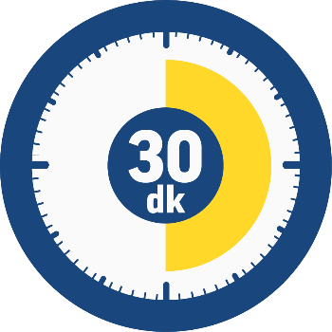
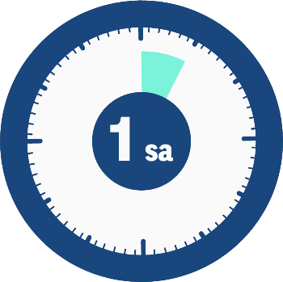
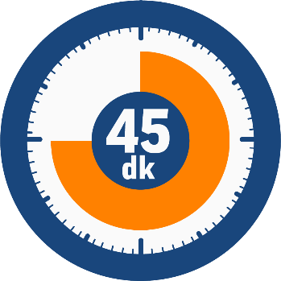
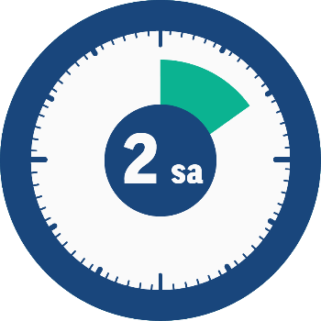
During the second 4 years of primary school an hour a day
Preschoolers
30 minutes a day
During the first 4 years of primary school 45 minutes a day
During high school 2 hours a day

Slide 14

Gambling
In the recent years, the betting on the internet has become more widespread. Since the betting is completed within 1-2 minutes, it causes faster and more pleasure. Therefore, especially the university youth and highly trained persons are possessed with a false confidence in this area and show tendency to this behavior.
Most especially the devices such as smartphones which give access to these websites everywhere and every time cause to reinforce this behavior and lead it to become an addiction.

Slide 15
Effect of Family in Gambling Addiction
Family factors which are protective against alcohol and substance use also protect the person against behavioral addictions. Because similar risk factors are effective in the development of behavioral addictions.
The lack of attachment and attention between the parent and child can cause the child who lacks of self-confidence to develop gambling addiction in his/her adulthood. The grown up person can feel the self-confidence that he/she lacked of in the childhood with gambling addiction through a distorted sense of achieving control.
Strong and positive family bonds, having clear rules within family, family’s support for the child’s family success and provide him/her social support are the critical factors in prevention of the addiction.

Slide 16
Treatments and the Role of the Family

Slide 17
Treatment of Tobacco Addiction
Family can encourage the young person to quit smoking. They can inform the young person about medical and psychological treatments in tobacco use.
The lack of knowledge of the young person about tobacco can be supplemented by using a scientific language.
Whether the other family members smoke or not effects the young person’s behavior of smoking critically. If the family member(s) quit(s) smoking, this can serve as a model for the young person.
Family can support a person’s behavior such as eliminating the anxiety, striving to solve problems and troubles as well as directing the person to treatment for him/her to develop these coping skills.

Slide 18
Treatment of Technology Addiction
Reviewing the child’s internet use and the time he/she spends on the internet
Having information about how the child spend time on the internet
Setting restrictions on internet use
Placing the computer in shared areas such as the living room
Kullanım kurallarına uymadığında uygulanacak yaptırımları kararlaştırmak
Helping the child to make use of the time
(Various hobbies and avocational)

Slide 19
Treatment of Gambling Addiction
It is required to address this pathological addiction as a family problem since the effects of this bad habit -which shakes the societies deeply and breaks up the families that are the foundations of the society- are not limited with the person. This disorder can be treated. Since the substance use treatment model is frequently applied in pathologic gambling addiction, manners of approaching of the families in substance use can also be applied to these people.

Slide 20



Treatment of Gambling Addiction
Family members setting financial limits for money management or another family member undertaking the financial responsibility, thus, preventing the addict from gambling
Developing strategies and being prepared against the addict who asks for money by begging, threatening or accusing
Providing support for ensuring that the person stands clear from the people that have a tie with gambling, the places where gambling happens and the gambling web sites on the internet
Encouraging both family members and the person who gambles to receive therapy support

Slide 21
Substance Addiction
Treatments in substance use are different to the approaches to other psychiatric disorders. There are several principles followed in intervention.
Each individual has his / her own problems. An effective treatment addresses not only the substance use, but also psycho-social needs.
Relapse
Prevention
Family
Counselling
Medical
Support
Psychological
Support
Intervention
Social
Support
Providing
Information

Slide 22




Treatment Stages in Substance addiction
Rehabilitation (6 months–2 years): Supporting the patient’s entry into long-term treatment programs and tracking their process.
Social re-integration starts in this stage.
Long Stage (4–24 weeks): Chronic medical conditions and mental problems are investigated and treated in this stage. Family counselling is a must at this stage.
Early Stage (0–4 weeks): Detoxification continues with psychological support. Motivational interviews are provided. Brief counselling is needed at this stage.
First Stage: Treating intoxication, withdrawal symptoms and medical conditions.

Slide 23


Treatment of Substance Addiction
The family is an important factor not just at the beginning of treatment, but at every stage of the process.
If treatment is to be successful, physical, emotional, social and family support are required.
Encouragement about recovery
Investigating treatment options
Emotional support throughout the recovery process
Being aware of signs of relapse and informing the treatment team
Supporting rehabilitation through participation
Organizing leisure time activities

Slide 24
Addiction Treatment in General
Addiction is a disorder that both affects and is affected by the family.
A number of psychological, social and financial problems emerge in the family when a member develops an addiction.
Family members often develop disorders in parallel to the addiction of the family member.
Most of the time, families have no idea how to deal with the problem.
After a while, the attitudes and behaviors of the family become part of the addiction problem, and need to be resolved.
Changing these attitudes can help the addict decrease their substance use and to seek treatment.

Slide 25
Important Aspects in Family Work
Setting boundaries
Developing empathy
Understanding the condition of addict in the family
Developing skills in assigning responsibility
Developing conflict resolution skills

Slide 26
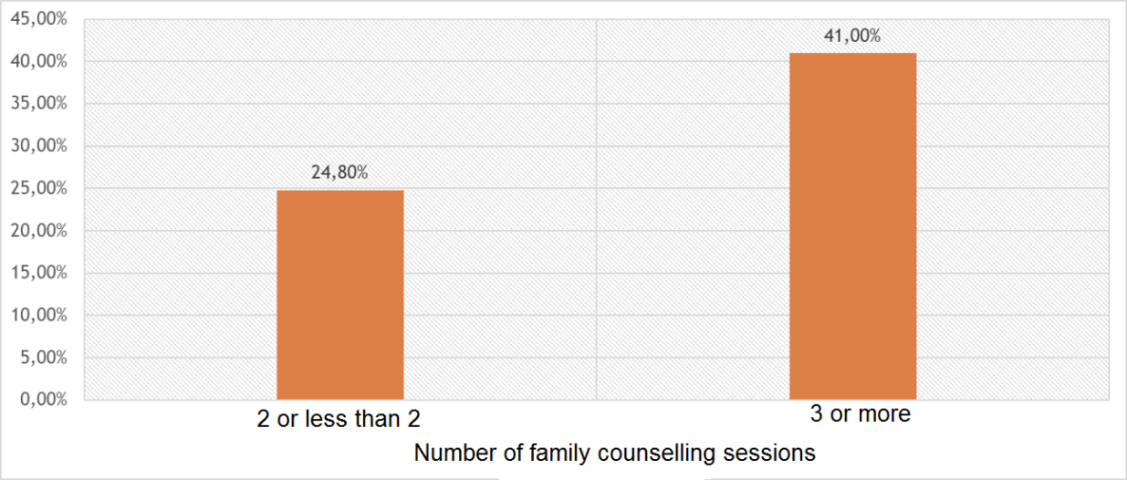
The Effect of Family Counselling Sessions on Abstinence
Attending fewer than two family counselling sessions leads to an abstinence rate of 24.8%
When more than 3 family counselling sessions are attended, the abstinence rate increases (41%).
(Odds Ratio=2.72 CI=1.99–3.71)

Slide 27
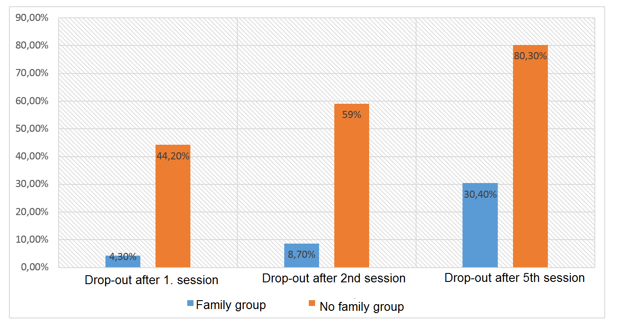
The Effect of Family Group Therapy on Drop-Out Rates
Notes:
İndividual and collective societies difference. Effect of family and impact on family are two main concerns of the society.

Slide 28
Thank you
Sultan ISIK
Turkish Green Crescent, CEO

