Slide 1
Experience of the countries of the Eurasian Economic Union in the implementation of tobacco control measures
Zykov Viktor
Deputy Head of the Department of risk factor prevention, Federal Research Institute for Health Organization and Informatics
of the Ministry of Health of the Russian Federation
Istanbul, 2019

Slide 2
2009-2010
Tobacco consumption levels
39% of people in Russia, including:
60% men and 22% women
25% of all adolescents (13–15 y.o.) smoked.
Health burden of tobacco use
300,000-400,000 of people in Russia died each year from tobacco-related diseases.

Slide 3
WHO FRAMEWORK CONVENTION ON TOBACCO CONTROL AND GUIDELINES
Russia joined the FCTC in 2008.
National tobacco control strategy was adopted in 2010.
Comprehensive tobacco control law was adopted in 2013 introducing a system of measures.

Slide 4
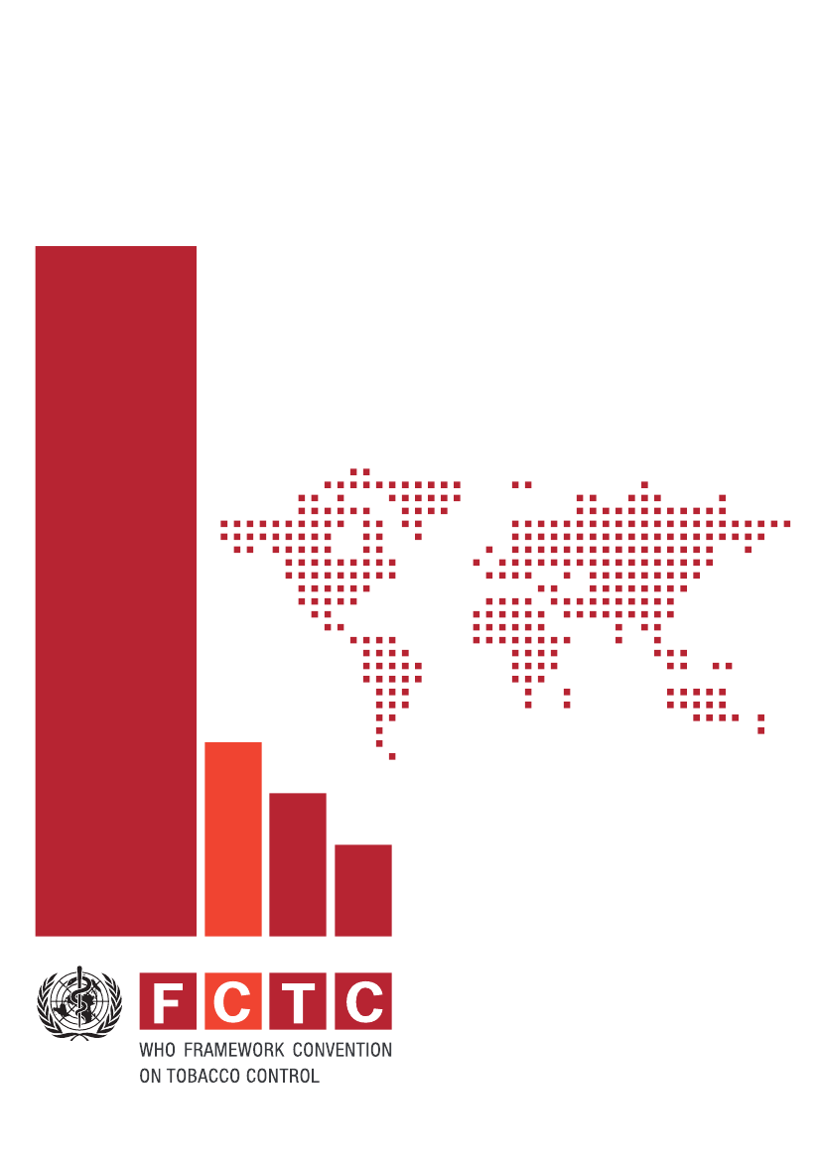
Consolidation
Civil society
Government officials
Media
Medical proffessionals

Slide 5
Tobacco control law
The law explicitly mandates:
Protection of public health policies from commercial and other vested interests of the tobacco industry;
100% smoke-free indoor public places;
Communication and public awareness;
Ban on tobacco advertising, promotion, sponsorship and point-of-sale cigarette display;
Restriction of sales, including internet sales;
Measure to reduce demand by addressing tobacco dependence and promoting cessation;
Elimination of Illicit trade in tobacco products.

Slide 6
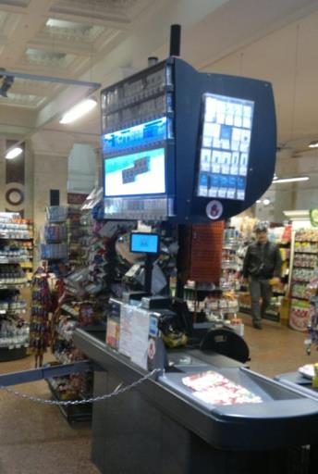
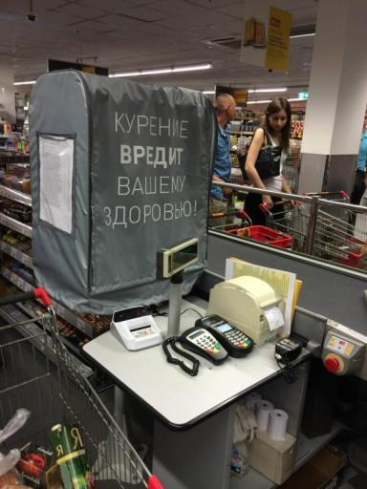
Before and аfter

Slide 7
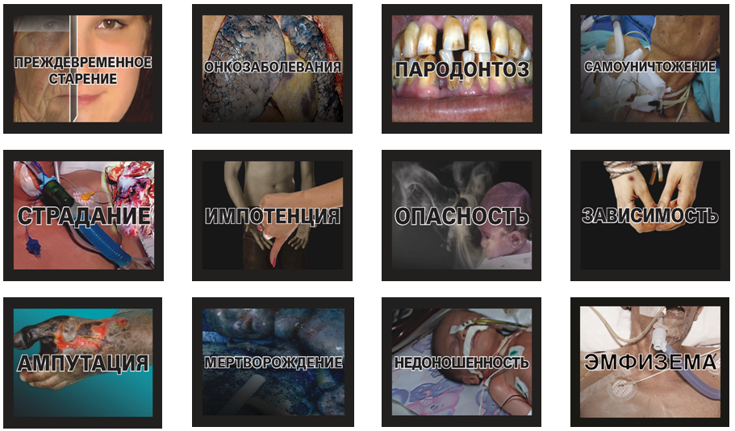
2013

Slide 8
Results
Prevalence of tobacco consumption among the adult population of the Russian Federation declined from 39.4 percent in 2009 to 30.9 percent in 2016.
Prevalence of tobacco consumption among adolescents 13-15 y.o. decreased by 2 times compared to 2004.

Slide 9
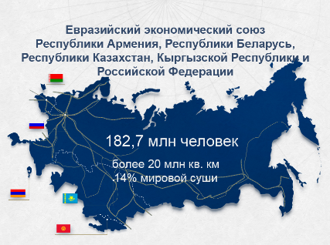
The Eurasian Economic Union of the Republic Armenia, the Republic of Belarus, the Republic of Kazakhstan, the Kyrgyz Republic and the Russian Federation

Slide 10
Eurasian Economic Union
Packaging and labelling of tobacco products
Regulation of tobacco product content disclosure
Regulation of the ingredients of tobacco products

Slide 11
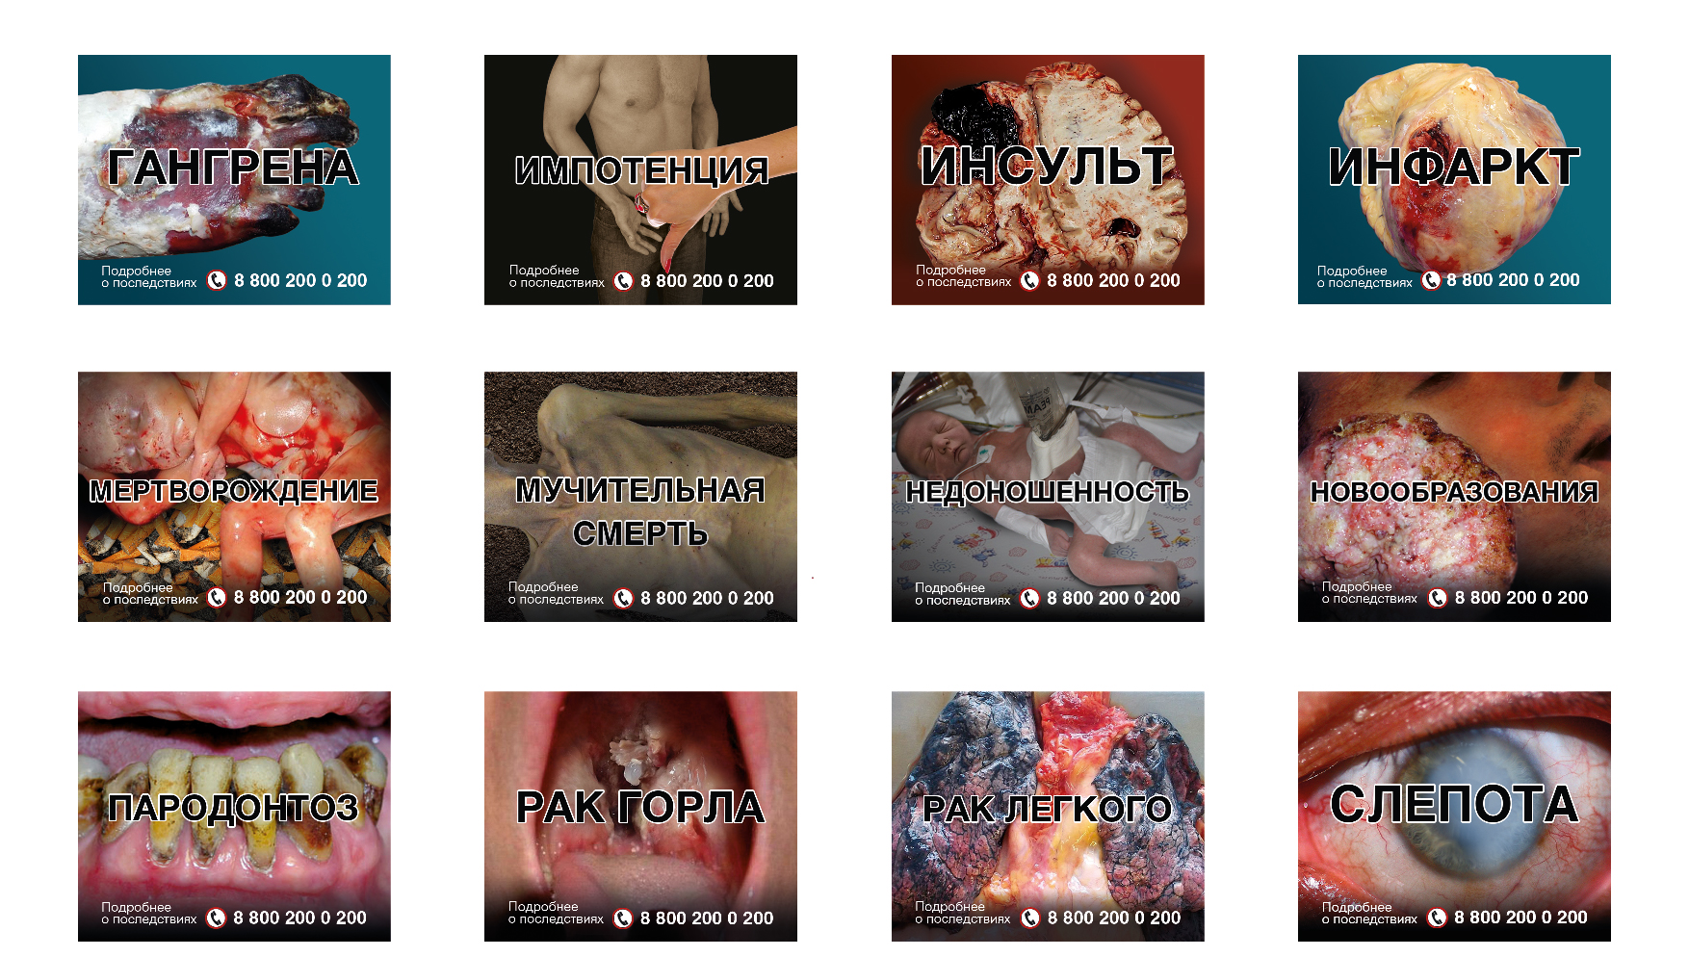
2017

Slide 12
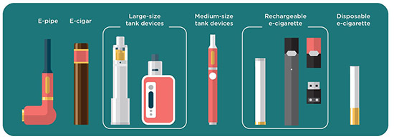
New products

Slide 13
Electronic Nicotine Delivery Systems (ENDS)
8.5% young people 13-15 y.o. used ENDS (10.3% of boys, 6.8% of girls) according to GYTS, 2015.
3.5% of adults 15 y.o. and older constantly used ENDS, including 5.4% men, and 1.9% women
(GATS 2016).

Slide 14
Electronic Nicotine Delivery Systems (ENDS)
Disposable closed systems
Closed reusable systems
Open reusable systems

Slide 15
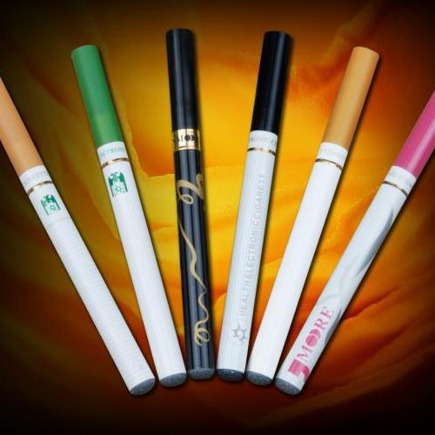
Disposable closed systems

Slide 16



New products
Closed reusable systems

Slide 17
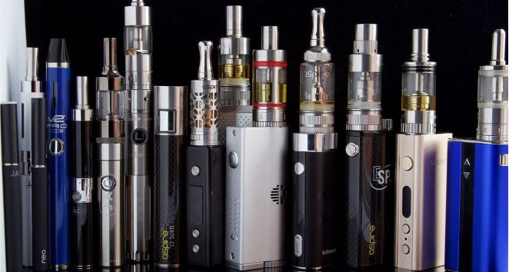
Open reusable systems
Open reusable systems

Slide 18

Closed reusable systems

Slide 19
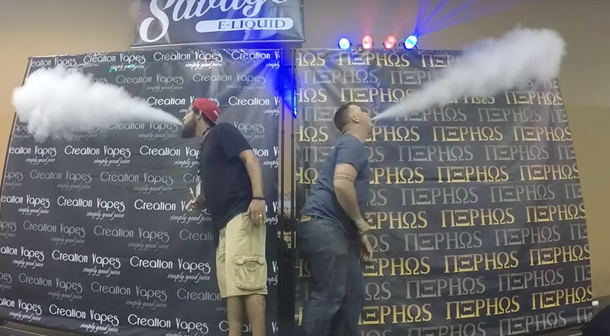
Open reusable systems

Slide 20
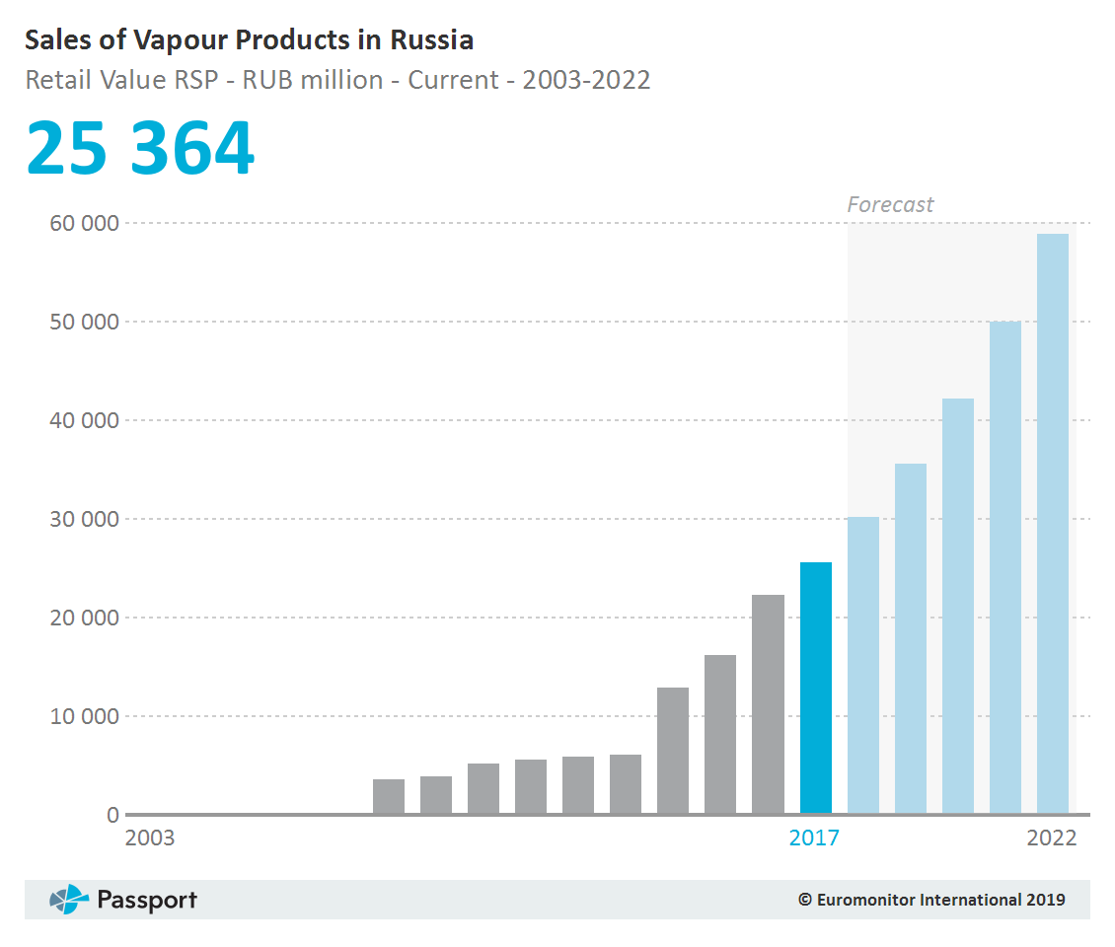

Slide 21
Outbreak of Lung Injury Associated with the Use of E-Cigarette, or Vaping Products
As of November 20th 2019, 2,290* cases of e-cigarette or vaping product use associated with lung injury (EVALI) have been reported to CDC.
Forty-seven deaths have been confirmed in USA (as of November 20, 2019).
One death has been confirmed in Belgium.
* https://www.cdc.gov/tobacco/basic_information/e-cigarettes/severe-lung-disease.html

Slide 22
Electronic Nicotine Delivery Systems (ENDS)
Some people use ENDS to consume cannabinoids, by inhaling vaporized ingredients
Over 30 countries banned ENDS

Slide 23
The Concept of implementation of the state policy to counter the consumption of tobacco and other nicotine-containing products
in the Russian Federation for the period until 2035
and further perspective includes application of measures applied to tobacco in relation to ENDS
RUSSIA

Slide 24
Armenia
Belarus
Kazakhstan
All countries have draft laws to equate ENDS with tobacco regulation
Kyrgyzstan
Russia

Slide 25
Thank you!

